Slide 1
SENG 301 D3
TA: Gabi Jurca
Group 17
Andrew Dong
Anthony Doan
Brian Brzezina
Charlie Cheung
Notes:
SENG301 Group 17’s D3 Prototype I.
Two prototypes, A & B for RPG Amiibo Land

Slide 2
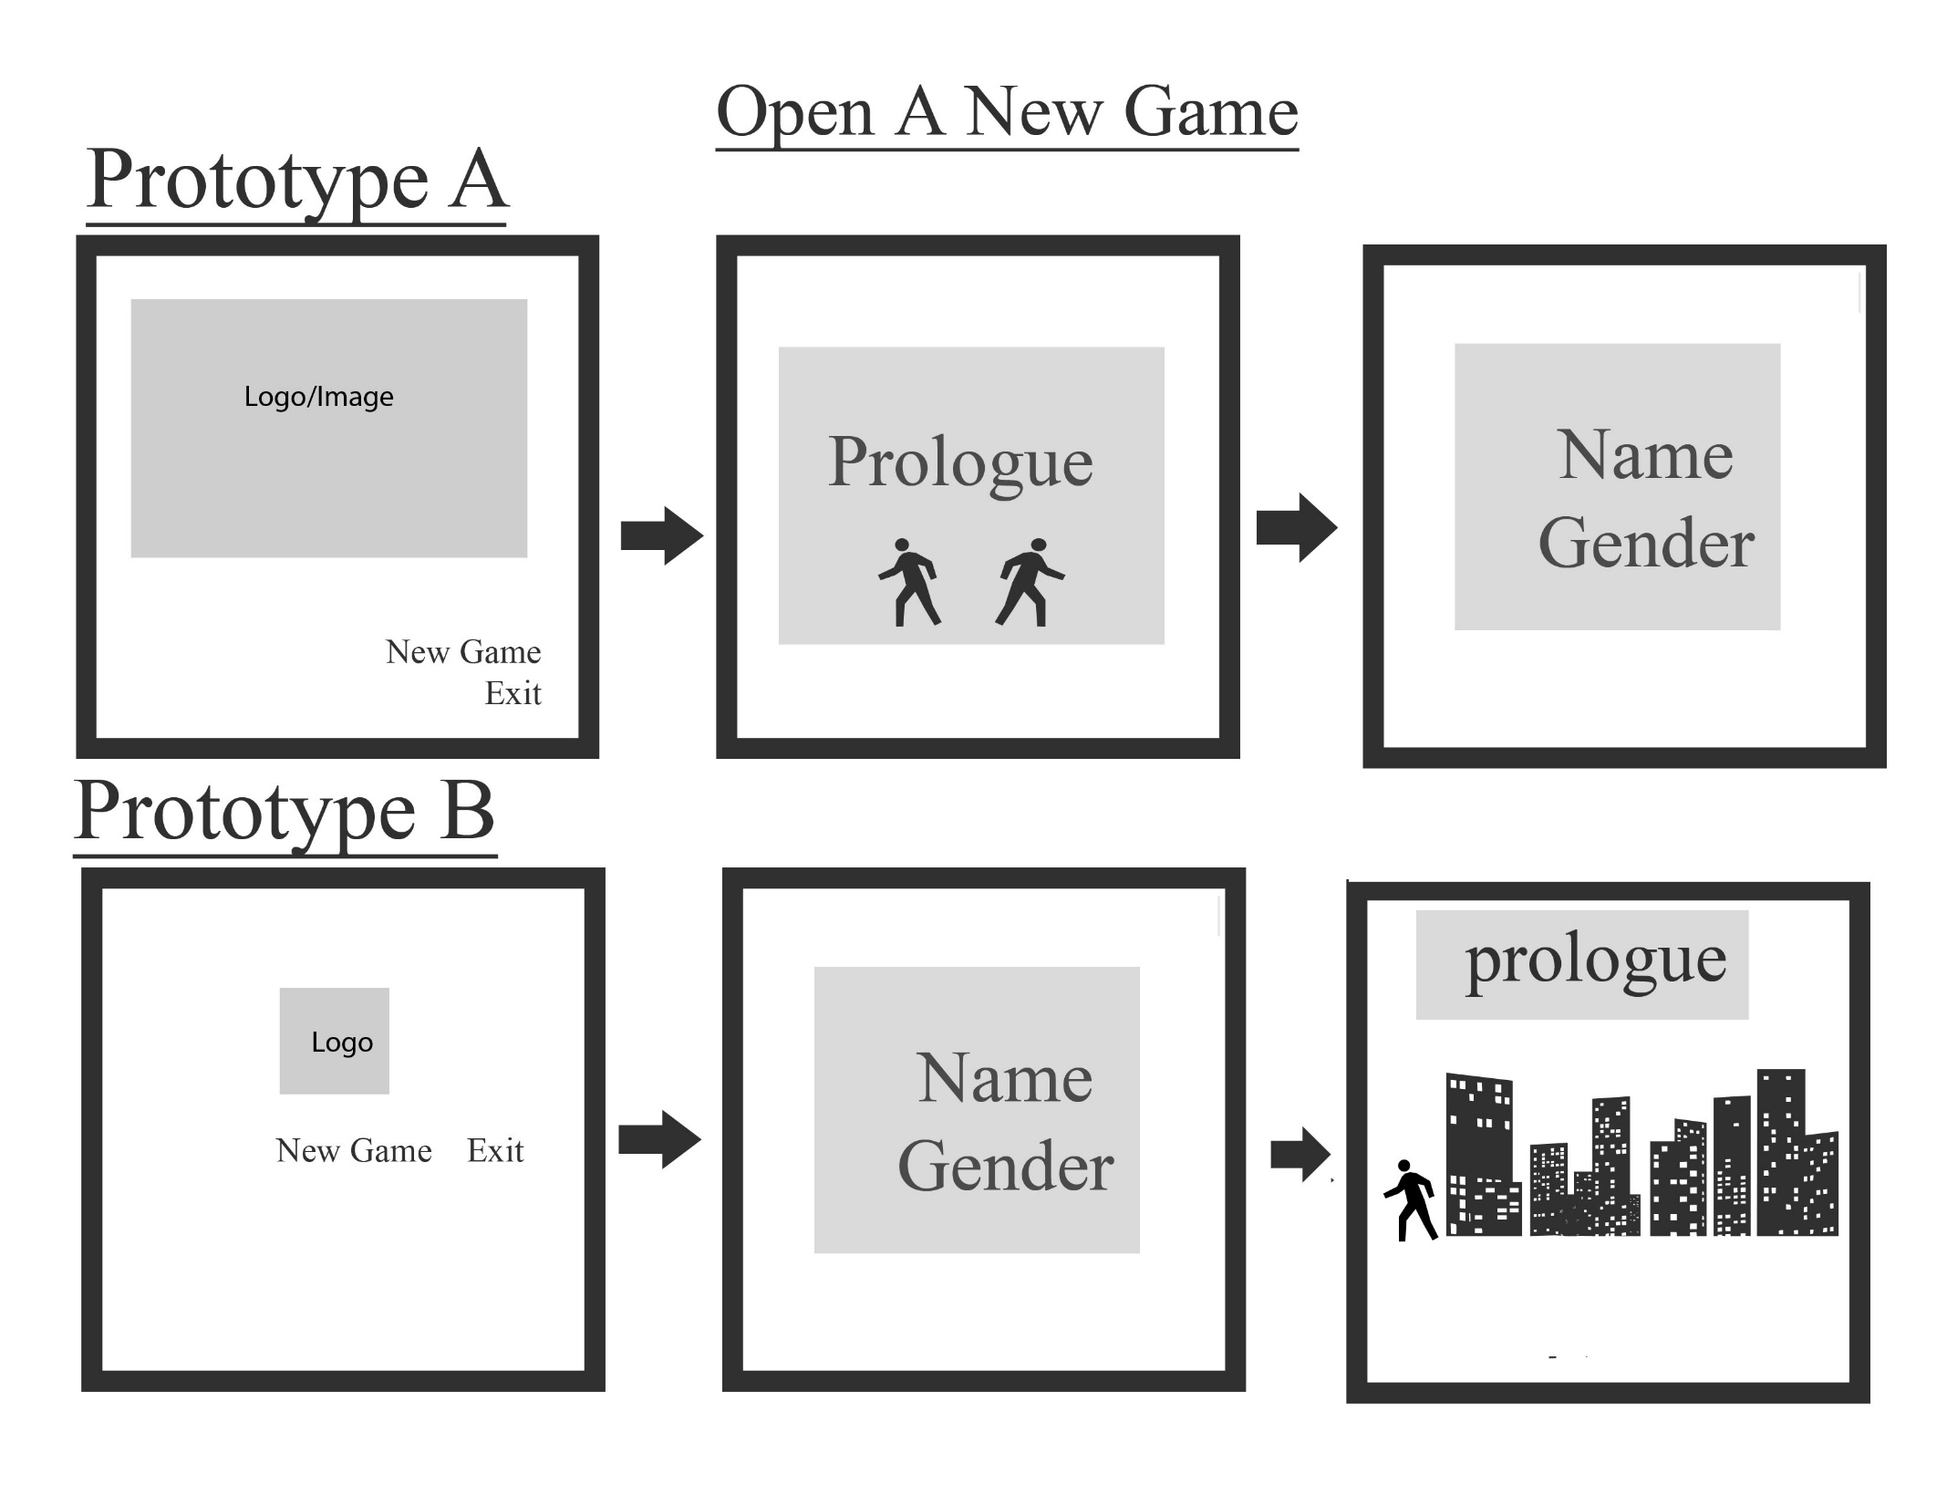
Notes:
This slide shows the game as users open it for the first time.
Prototype A
Left panel presents the title/logo/image of the game. Two selections are underneath for “New Game” and “Exit”. By selecting “New Game”, users will move to the right panel. However, if the user had accidentally opened the game, selecting the “Exit” will close the game. The prototype presents the prologue to the original story created for the game. Underneath, a preview of the player’s sprite options are viewed. The farthest right panel will then ask users to enter a name and the gender they would like to play as in the game.
Prototype B
The left panel opens up with only the logo of the game in the center of the screen and two options underneath. Like Prototype A, Prototype B has an “Exit” selection on the screen that allows users to quickly close out of the game. By selecting “New Game”, the user moves to the center panel and is asked to input their Name and Gender. The user transitions to the first map of the game and the prologue is place above in the dialogue box.
Our group decided to go with Prototype A for the opening game screen because it is visually more appealing. The opening screen will present to the user the title of the game and an aesthetically appealing image before the users dive into the game. The user is also made to focus on the story of the game because the prologue is presented first. The name and gender come after which allows for customization when playing the game. Users are able to use any name they choose and play as either male or female. A disadvantage for Prototype A would be how users cannot skip pass the prologue(modal dialog) which may upset hasty players. However, our original story is one of the main features of our game, we intend to make it interesting enough for users to want to read and be engaged in the game. We hope users will gain much more satisfaction from the game’s story by ordering the prologue and the name/gender customization in this way.
Prototype B is a much simpler design to implement and can be done much more quickly, however it lacks visual appeal. Another one of our features is custom graphics. Because we are making every texture, the logo, the sprites, and the characters, Prototype B would not promote our originality as much as it should. Also, transporting the user straight into the map could tempt users to quickly skip past the prologue and begin exploring without care for the story.
For these reasons, we have chosen to follow Prototype A for our opening new game screen.

Slide 3
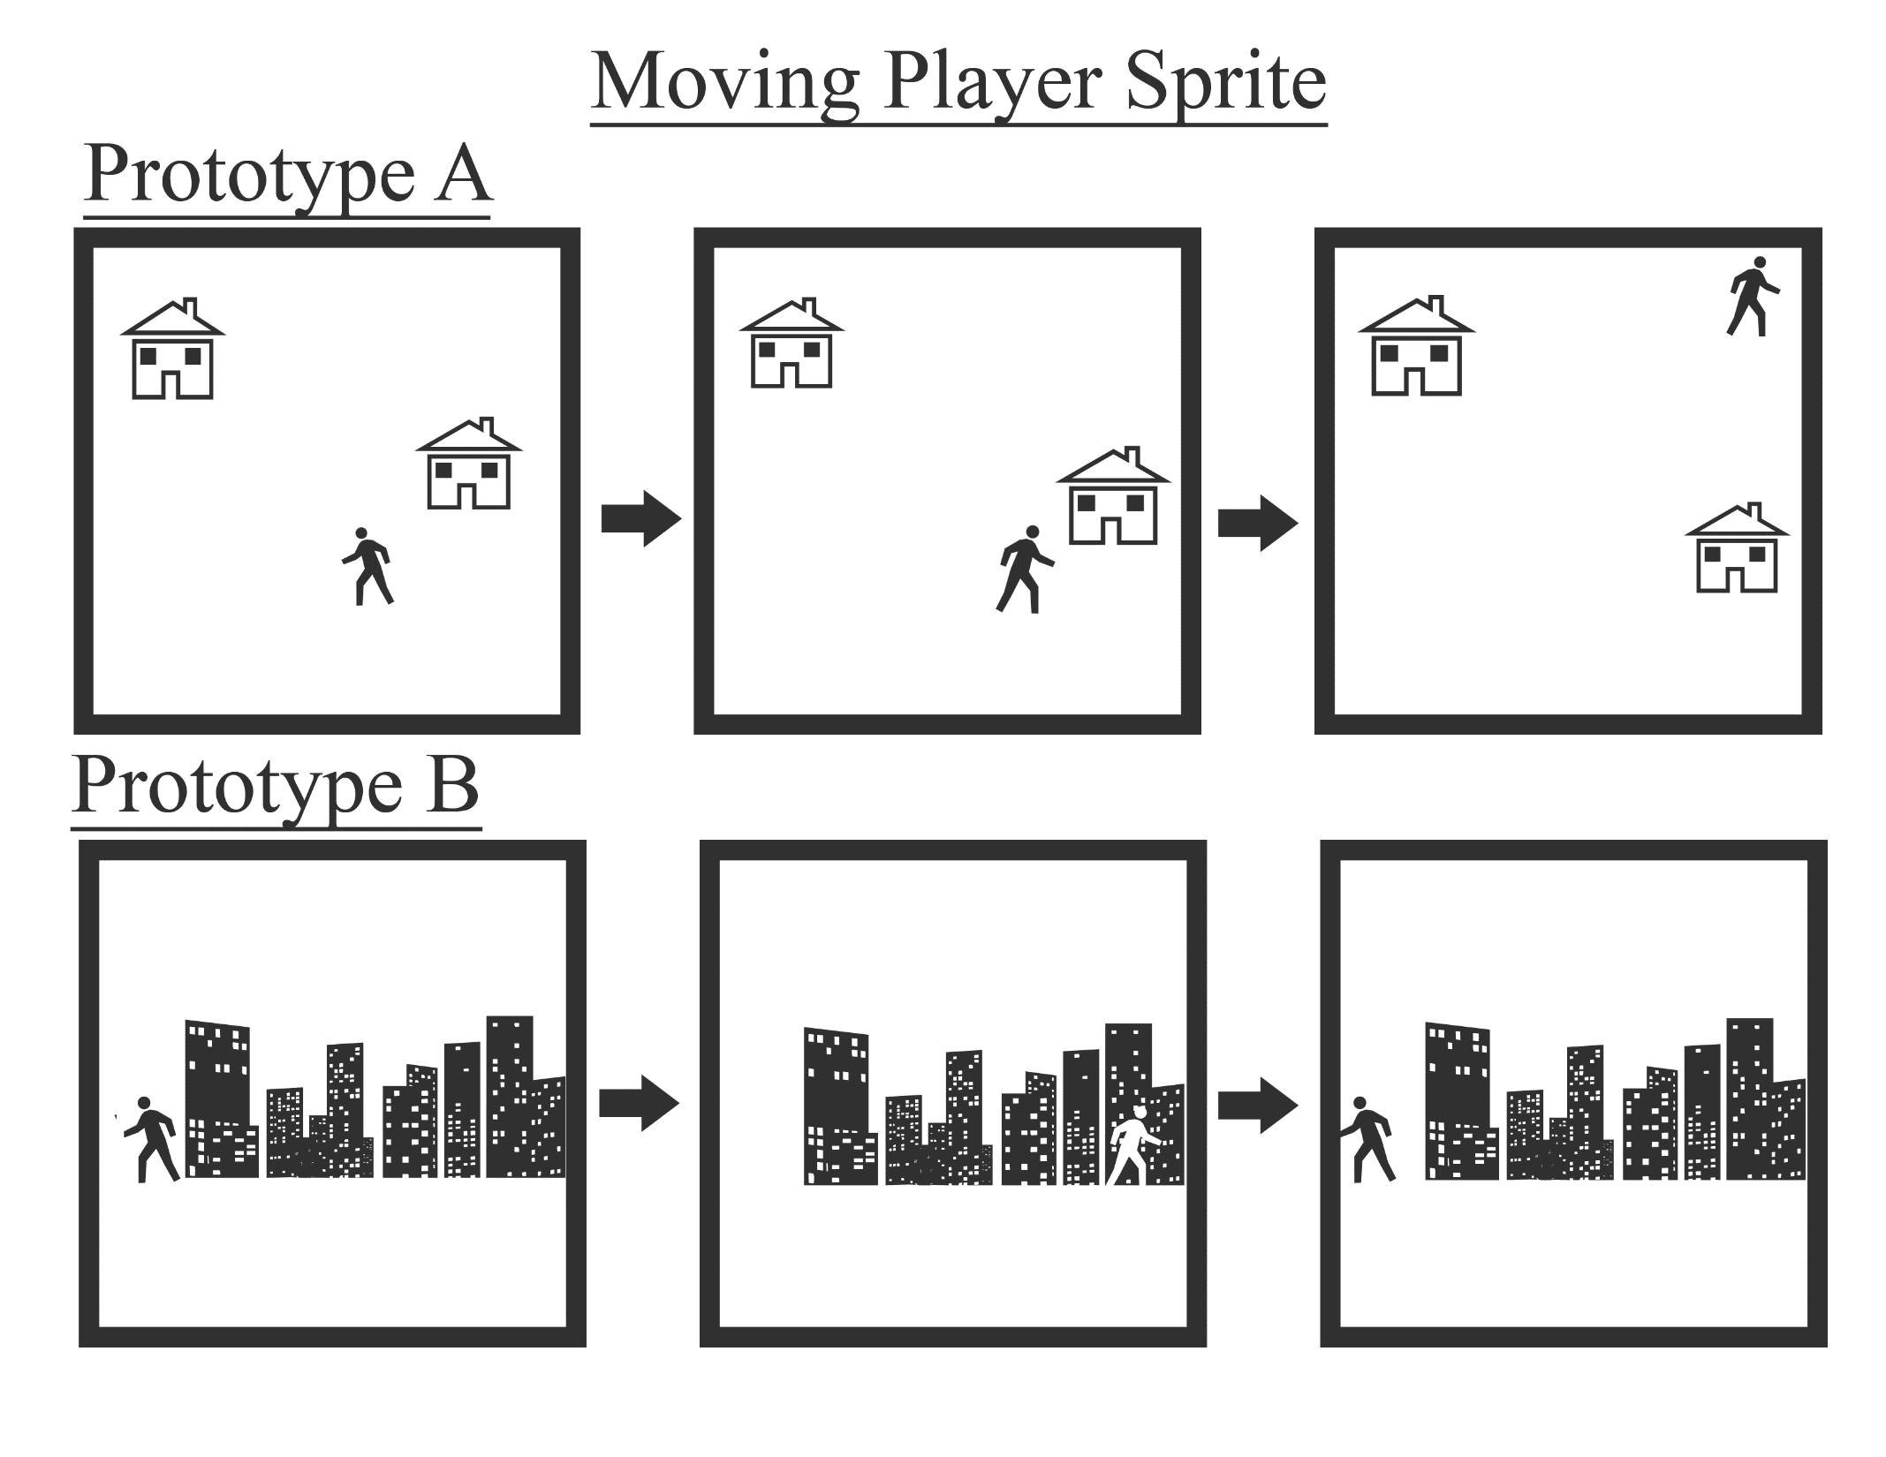
Notes:
This slide shows how the player will interact with the game environment
Prototype A
Prototype A shows the user in an over world map and how the user is able to move up, down, left, and right on the map. However, if like in the rightmost panel, the user reaches the edge of the map, they will not be able to continue walking in that direction.
Prototype B
Prototype B shows the user in a side scrolling environment. The user is able to move right and left only as the buildings behind them move in the background. Users in Prototype B are able to move as far right or left as the map extends.
Prototype A was selected for the player and environment interaction because an over world view of the map is much more suited for RPGs. Users would want something they are familiar with and an over world view would be easy to learn for new users to RPGs and familiar to veterans in RPGs. The sprites would take longer to animate because they have to be rotated and flipped in all directions and we would have to increase the number of frames for each sprite. Because one of our main features is custom classic graphics, each image would have to be split up into a tile and drawn separately. However, this would give users the best experience in interacting with the map. By seeing the entirety of the map in Prototype A, a new user will easily be able to understand that they are able to explore up, down, left, and right. This prototype is much more learnable.
Prototype B would allow for more detailed backgrounds. Buildings would not have to be so pixelated as they are not in tile form like Prototype A. The main disadvantage for Prototype B would be how it does not look like it is inviting to explore. Users are very limited in their movements because they can only move in two directions. The user will also have little to no knowledge of what they are able to explore because of the separation between the character sprite and the buildings. Portals could be easily disregarded by players and for younger players, it could be difficult for them to remember what was seen on the previous screen when exploring. After a long period of not using the game, players may not be able to recall what was located on each screen of the scrolling map. There is no memorability in designing the game like this.
We believe it would be ideal for users to see as much as they can on the map and have the freedom to walk in any direction. For these reasons, we have selected to continue with Prototype A.

Slide 4
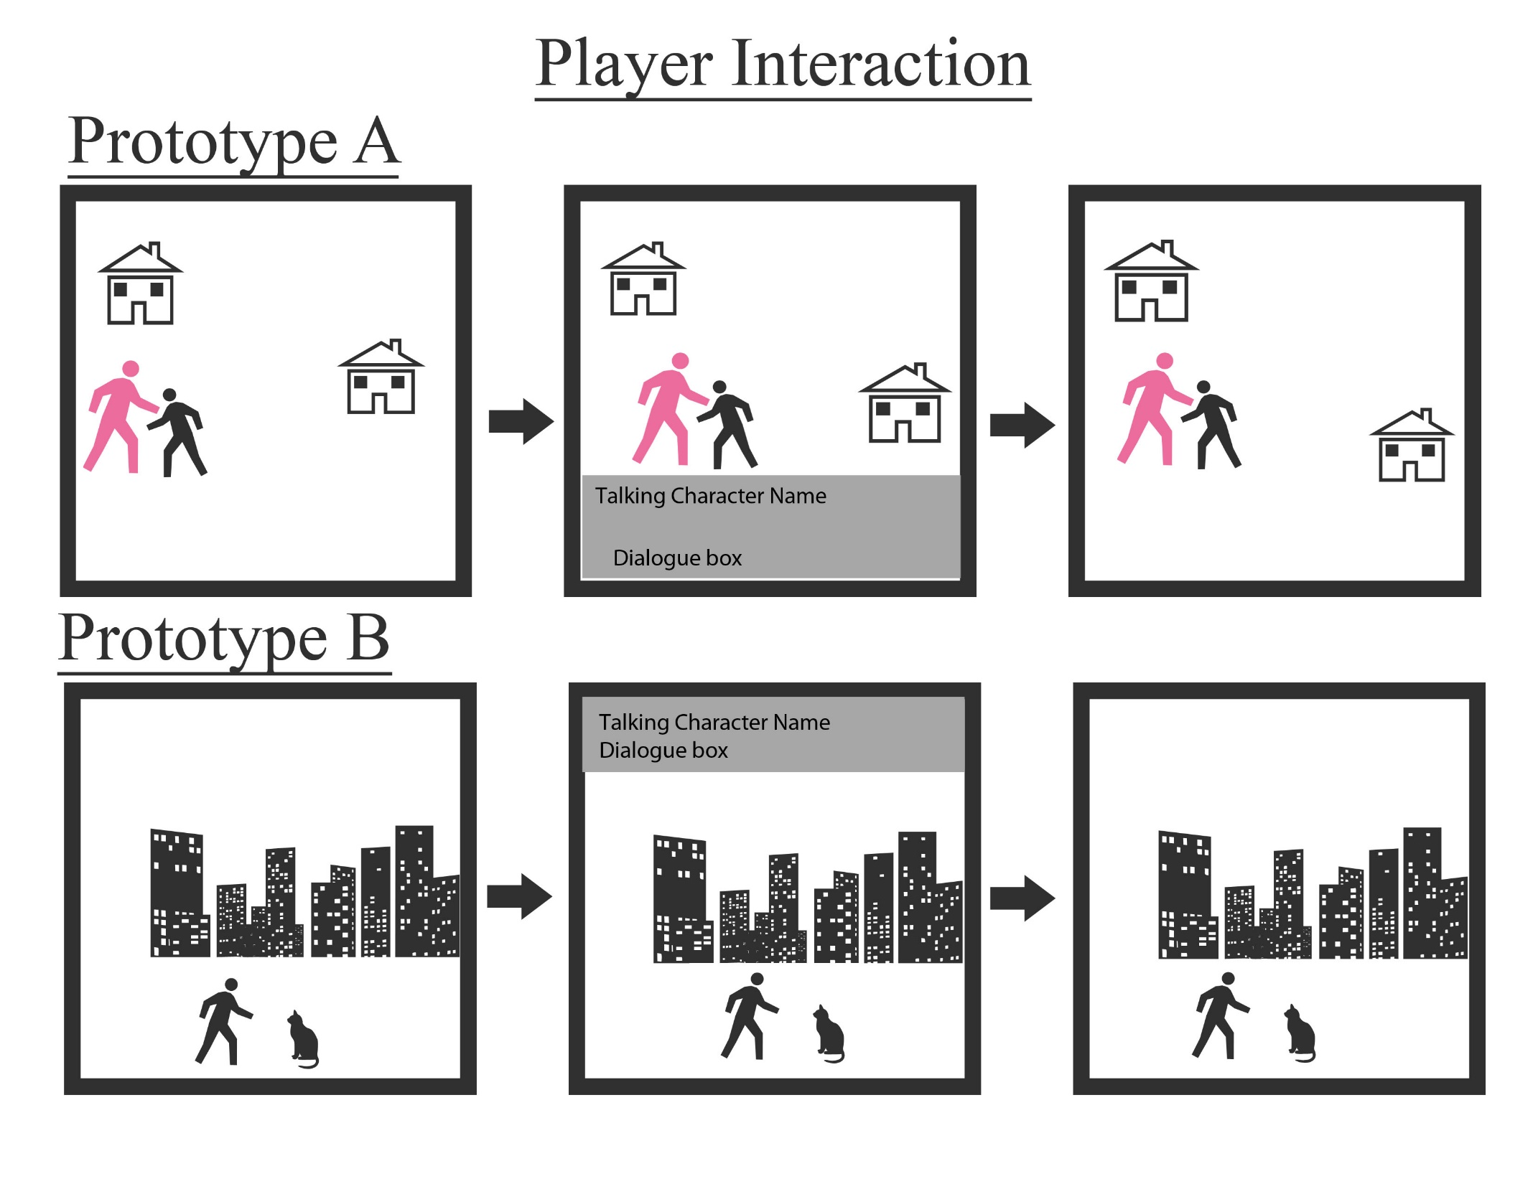
Notes:
This slide shows how players interact with NPCs in the game.
Prototype A
For Prototype A, a player is able to interact to a NPC by walking up to them. Moving to the center panel, by pressing a command, a dialogue box opens up on the bottom of the map that displays the character’s name and the dialogue. By pressing another command, the dialogue box closes and the player can continue interacting with the map.
Prototype B
In this prototype, a player walks up to the NPC to interact with it. The dialogue box along with the name of the character speaking pops up on the top of the screen. By pressing another command, the dialogue box closes up and the user is able to continue exploring the map.
In both Prototypes, users can only converse with certain NPCs. If a user attempts to interact with, for example, a boulder, the dialogue box will open but there will be no response from the boulder. The dialogue box will close afterwards.
Following the previous slide, Prototype A was selected in this case as well. The user will be able to see were they are located on the map while talking to the user. After the presentation of our Prototypes, it became very clear that both of these Prototypes are very text heavy. The main difference between them that was discussed was the location of the dialogue box. Because Prototype B is a side scrolling game, buildings are much taller than in Prototype A and the player walks very close to the bottom of the screen. Therefore, the dialogue box for Prototype B must be moved to the top of the screen.
To improve player interaction, we will make Prototype A more visual by drawing the NPC and the character sprites in a more detailed art style to pop up along with the dialogue box. This will give a clearer picture of the characters interacting with each other and put more emphasis on the story portion of the game. As text is displayed to the user, sound effects will also be used to increase the focus on the text. Both these adjustments will be added to Prototype A and will enhance our classic custom graphics and original RPG features. We hope this will connect users to the story and the characters to a greater degree.

Slide 5
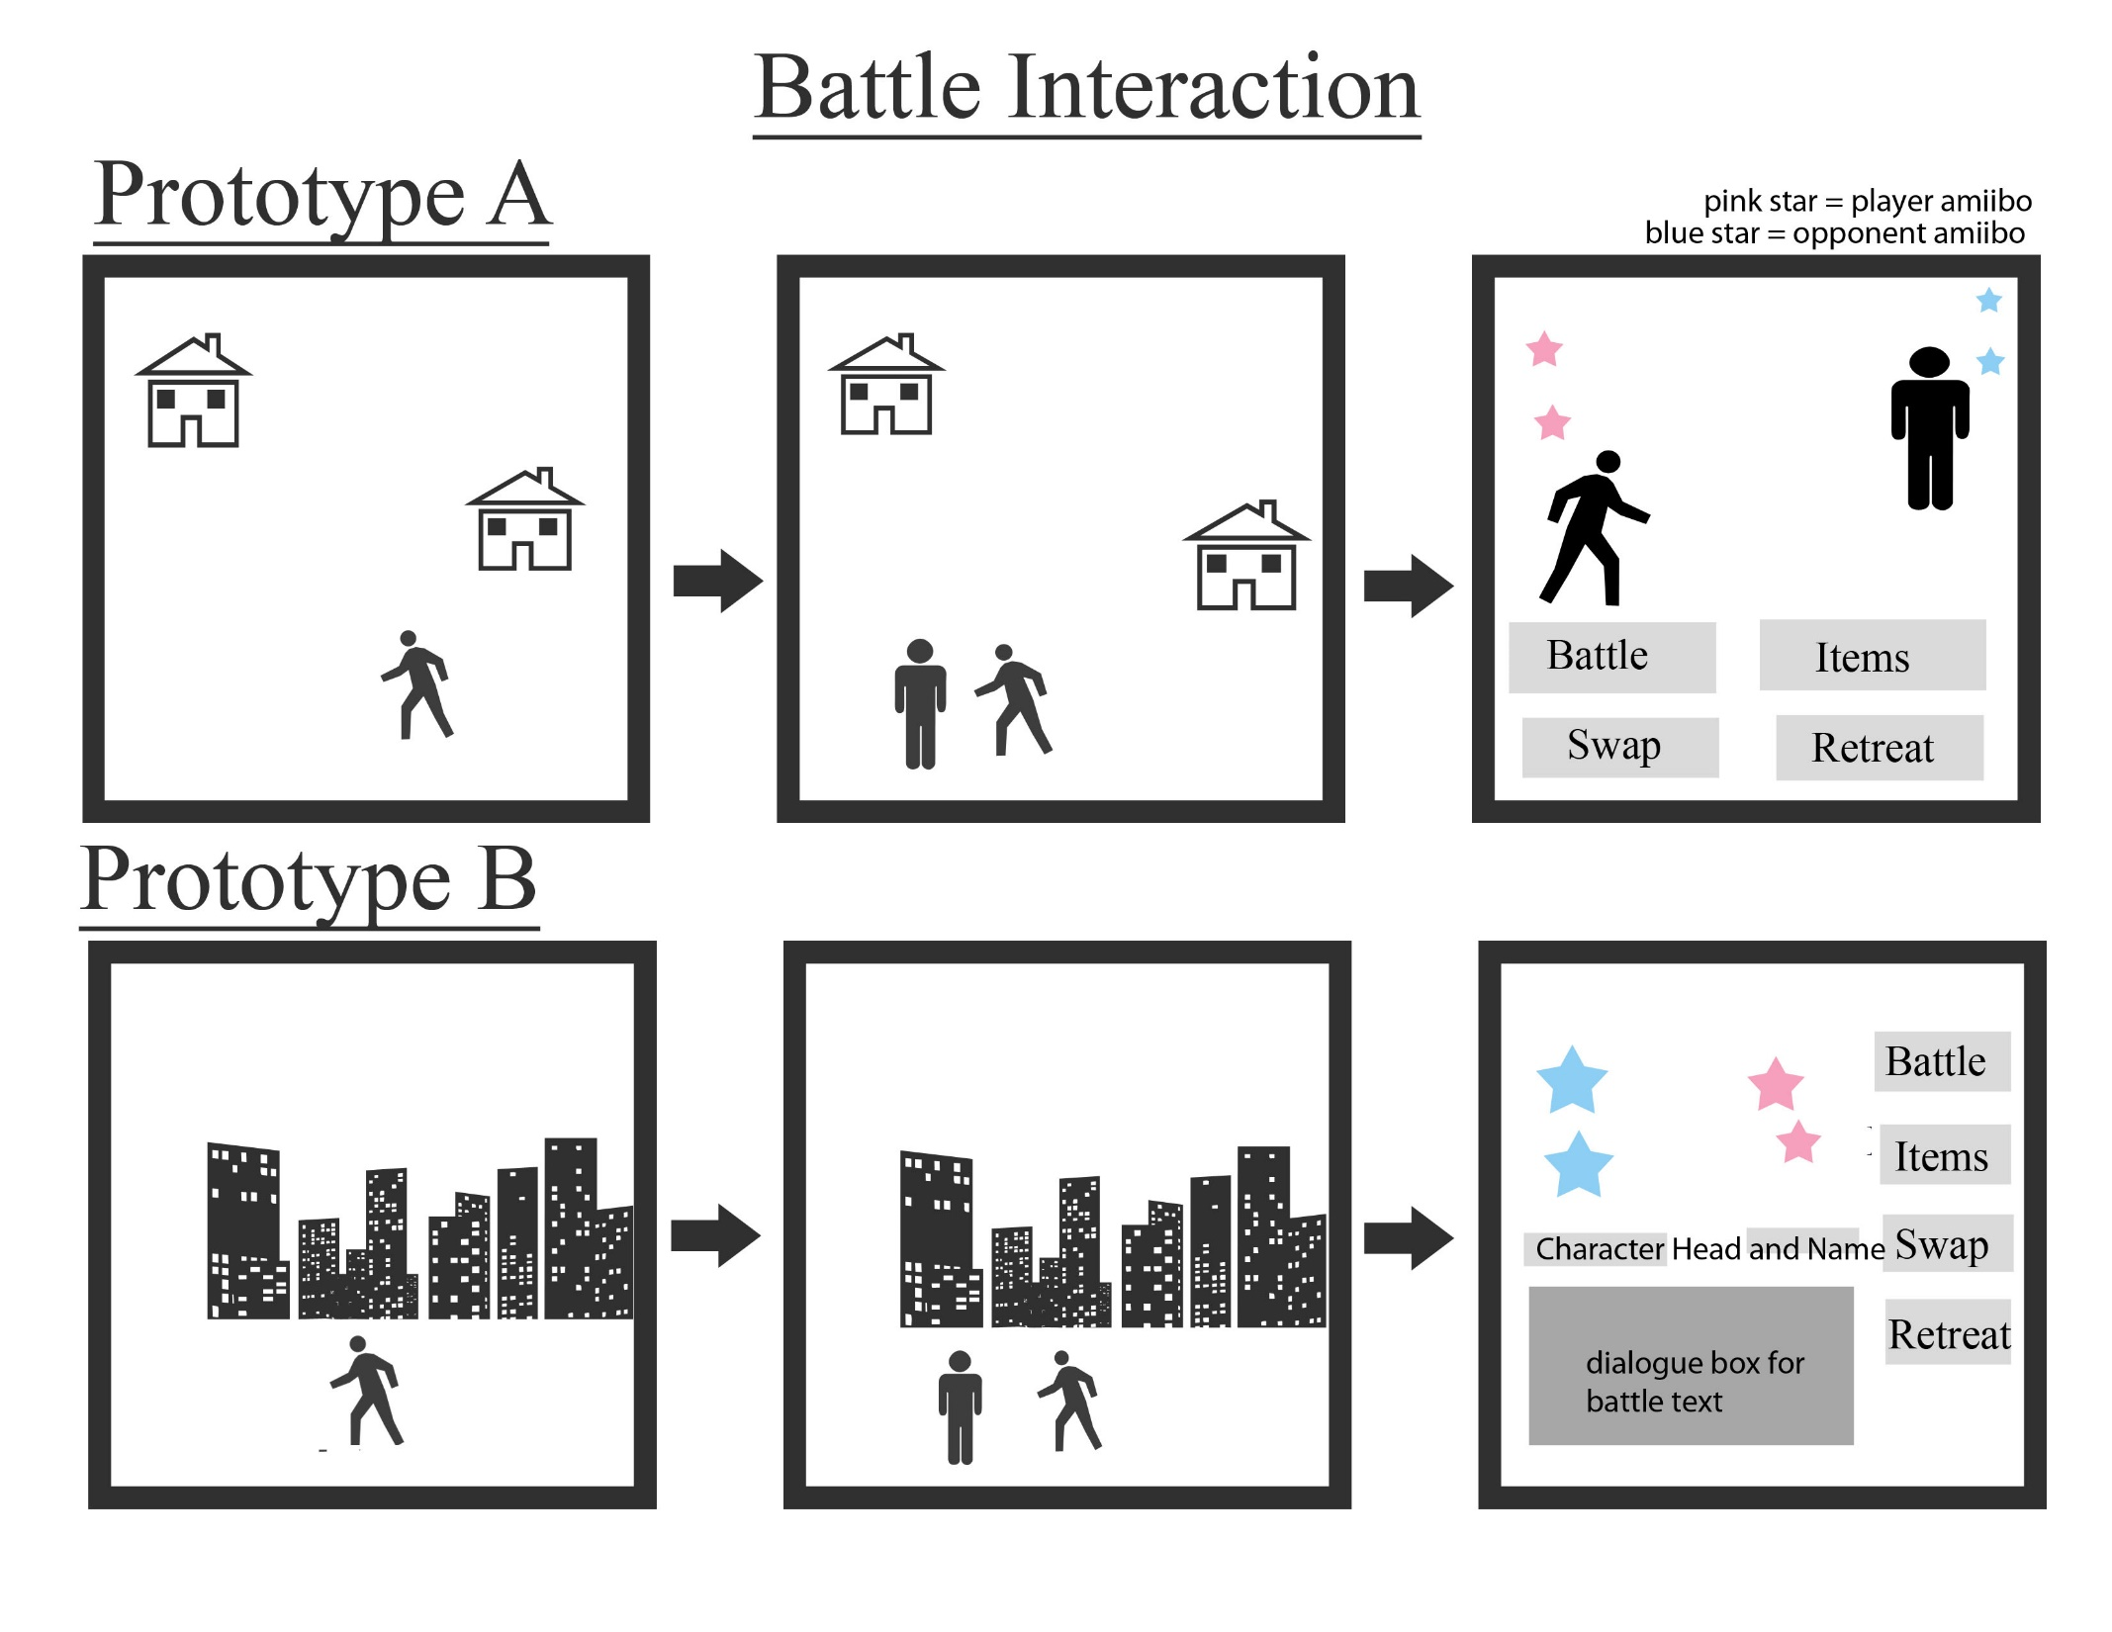
Notes:
This slide shows the beginning of the battle interaction feature of our game
Prototype A
As the user interacts on the map, a battle could randomly occur when the user walks in front of an NPC. The user will continue to the right most panel. There, the pink stars represent the user’s amiibos and the blue stars represent the opponent’s amiibos. Four widgets are placed underneath: Battle, Swap, Items, and Swap.
Prototype B
Users in this prototype will also be able to battle with NPCs after walking in front of them. They are then transported to the rightmost panel were only the amiibos are displayed to the user. The name of the character the amiibos are fighting for are written underneath. A dialogue box for battle text will take up the majority of the screen to display information to the user. The dialog box will also present the user with all feedback throughout the battle. The same options: Battle, Items, Swap, and Retreat are displayed as widgets to the user on the side of the screen.
For the battle screen, our group decided to follow through with Prototype B. After our prototype presentation, it seemed our prototype would be too text heavy. To combat this, the character’s head will appear along with the name during the battle screen. It seemed Prototype A would be too plain and it also provided no explanation to the user about the proceedings of the battle. By having a dialogue box like in Prototype B, the user will be notified whose turn it is, the Amiibo attacking, how much damage will be calculated, and which attack the chosen Amiibo will be using. Prototype B removes the character sprite from the battle screen, however this allows for more room on the screen to customize battle actions. By using Photoshop, we will be able to customize attack animations for each Amiibo to improve gameplay and visual appeal. One disadvantage with this prototype is how the screen could easily seem crowded to the user. We will further improve on this prototype by optimizing the design and layout of the screen.

Slide 6
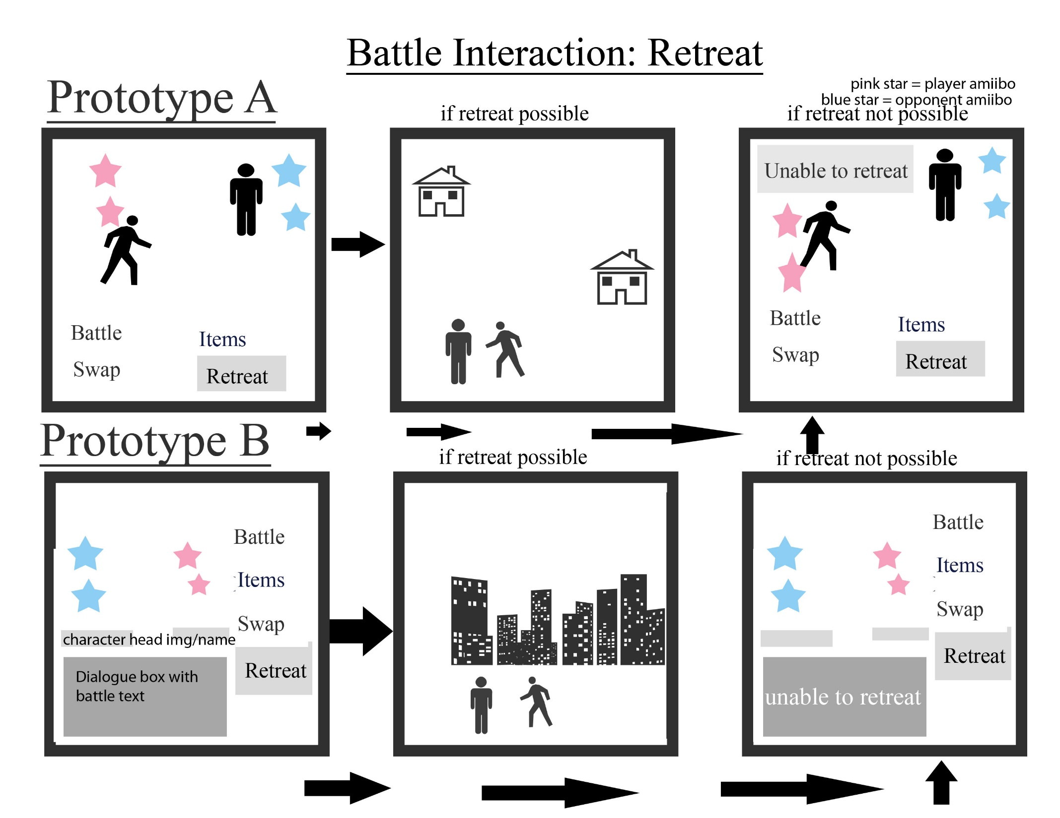
Notes:
This slide shows the Retreat option during Battle.
Prototype A
In the leftmost panel, the user selects retreat. If retreat is possible, the user will move to the center panel where they are transported back to the map they were on previously. However, if the battle in progress is a boss battle, the user will move to the right most panel where they are unable to retreat. A dialogue box will pop up to the user alerting them that they cannot retreat from this battle.
Prototype B
Prototype B follows the same conventions as Prototype A. If a retreat is possible, the user will move to the center panel where they go back to the map they were on right before the battle started. However, a battle with a boss does not allow the player to retreat. The user will then go from the left most panel to the right most panel. The dialogue box on the bottom of the screen will tell the user they cannot retreat from the battle.
In keeping with our battle interaction design, we have selected Prototype B for the retreat option. However, because our map layout is like Prototype A, by retreating from a battle, the user will return to the over world view of the map much like the center panel of Prototype A. Prototype B was selected in this case because the text alerting the user that they are not able to retreat from the battle will appear in a location the user is used to text appearing in. A disadvantage of Prototype A is that the text telling user’s that they cannot retreat will appear suddenly and disappear. This would most likely cause users to miss the text. However, because the text box in Prototype B is in a fixed position, users will know where to look when their retreat does not work. After the user is alerted that the retreat is not possible, the user must continue with the battle.

Slide 7
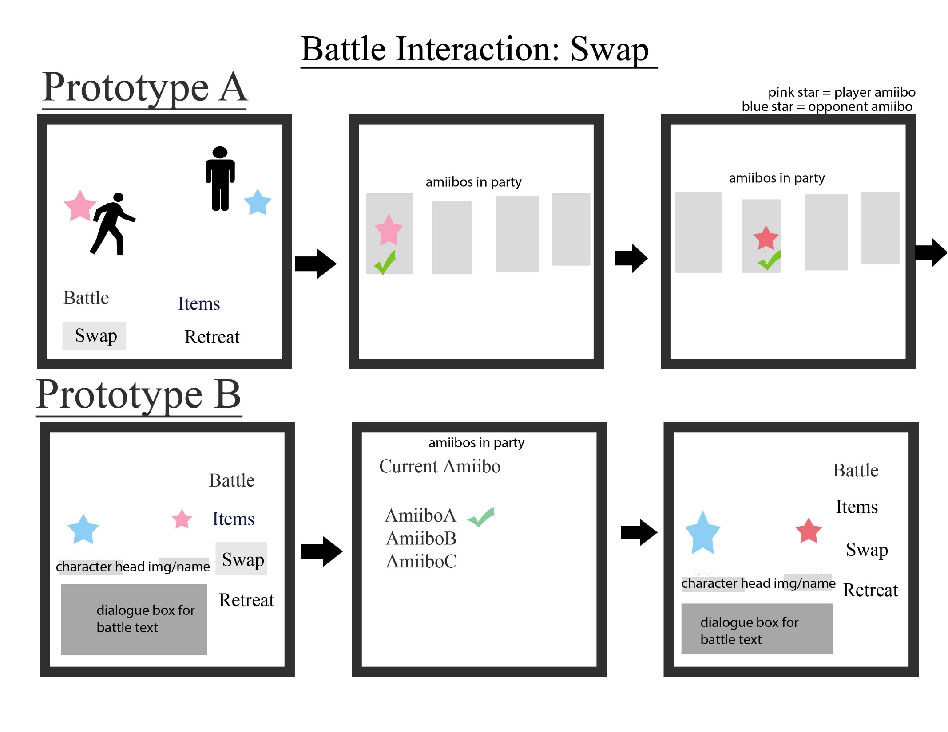
Return to battle screen
Notes:
This slide shows the swap option during the battle part of our RPG.
Prototype A
When users select the swap option they will move to the center panel where all amiibos in the user’s party are displayed. The Amiibo currently in battle is indicated in the center panel. The user will be able to toggle through the amiibos and like in the right most panel, select another Amiibo to swap with the Amiibo in the center panel. The newly selected Amiibo is identified by a darker pink.
Prototype B
Prototype B allows the user to select the swap option like in the leftmost panel. After the selection, the players moves to the center panel. There, the Amiibo currently selected is written in text on the top of the screen. The rest of the amiibos in the players party are in text underneath. The user will the be able to select which Amiibo they would like to swap in. Once selected, the user will be brought back to the battle screen, the star in a darker shade of pink represents the newly selected Amiibo. The dialogue box will display a message to the user explaining that the user has swapped their Amiibo.
In this option, we have selected to use Prototype A because it is much more visually appealing to the user. The battle screen layout in Prototype B will then move to the center and right most panels in Prototype A. Then it will return to Prototype B. This way, the user will be able to see an image of all the amiibos which would make it easier to recall which Amiibo is which whereas only seeing text would prove difficult if the user had only returned to the game after a long time away from the characters and the systems. One issue we came up with during our discussion was the ability to cancel the selection for a new Amiibo. To resolve this issue, a button will be added to the Swap page for the player to return to the battle screen.

Slide 8
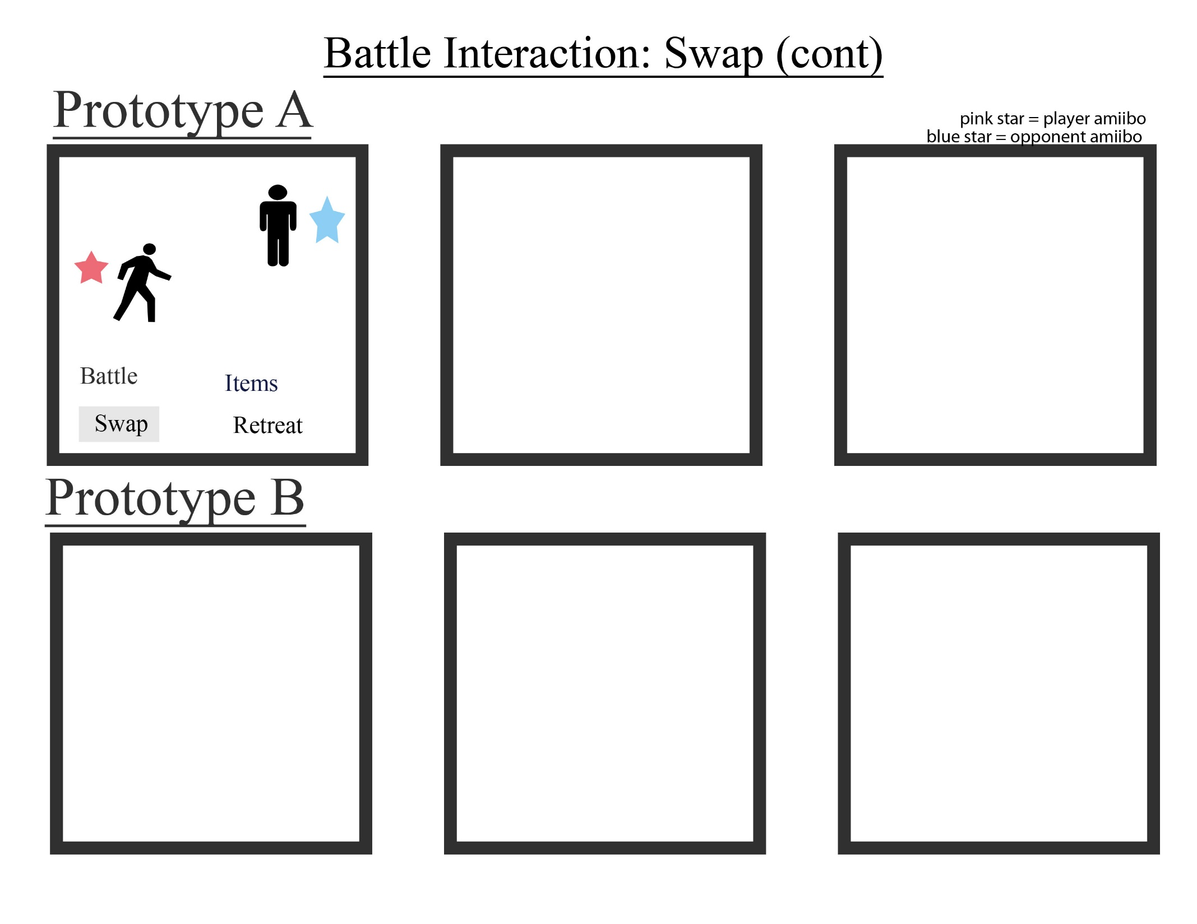
Notes:
This slide is a continuation of Prototype A’s swap option.
Here, the player is returned to the battle screen with the new Amiibo ready to battle.

Slide 9
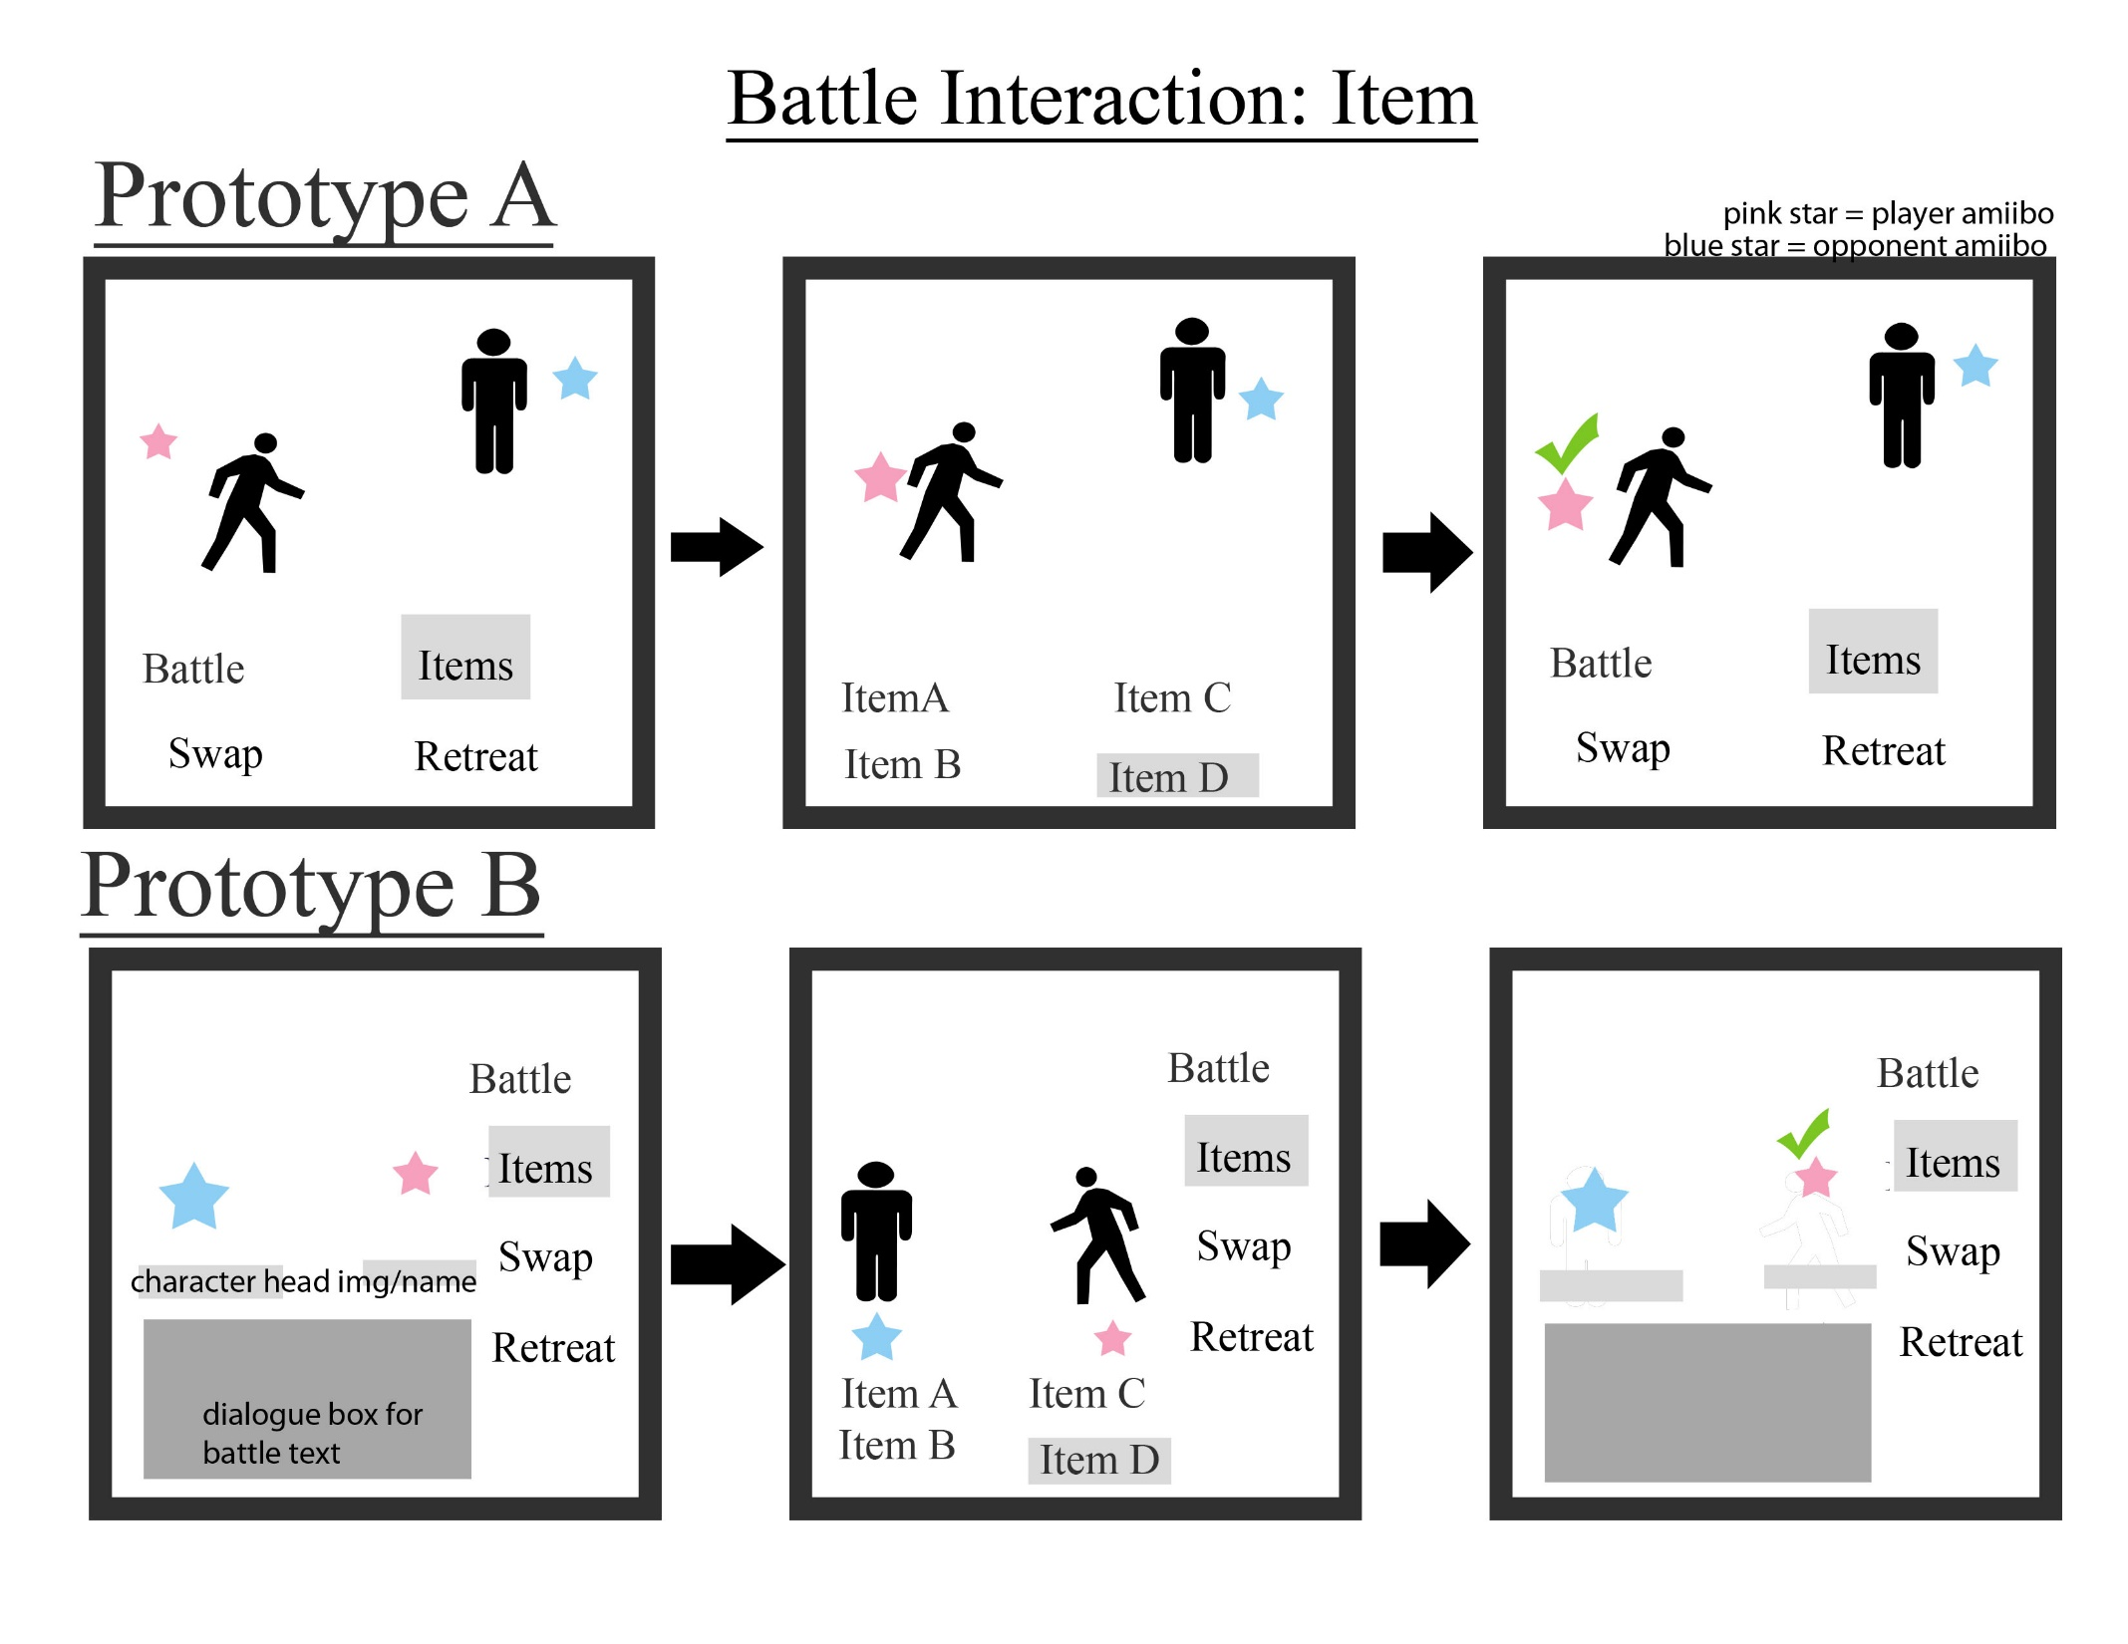
Notes:
This slide shows how the player will use an item during battle.
Prototype A
The player selects the item option in the left most panel, moving to the center panel, the list of items available to the user are displayed on the bottom of screen. In this case, the user selects itemD. The right most panel shows how the Amiibo to which the item has been applied to is indicated to the user. The player can then continue with their turn.
Prototype B
The players selects the item option and moves to the center panel from the left most panel. A list of items is displayed to the user and the screen moves to the right most panel. The Amiibo to which the item has been applied to is indicated to the user.
In this case, Prototype B is chosen in it’s entirety. Once again, we ran into the issue of having the panels be too text heavy. To combat this issue as discussed, we will use images with the title of the item underneath. To provide feedback to the user, if an item is unavailable or ineffective, an error message explaining this would be displayed to the user in the dialogue box. This will help users retain the user of each item easier. After selecting which Amiibo the item is applied to, the dialogue box on the bottom of the screen summarizes the actions of the user. By having this text, the user will be able to confirm whether their action has been completed. For these reasons, we have chosen to use Prototype B.

Slide 10
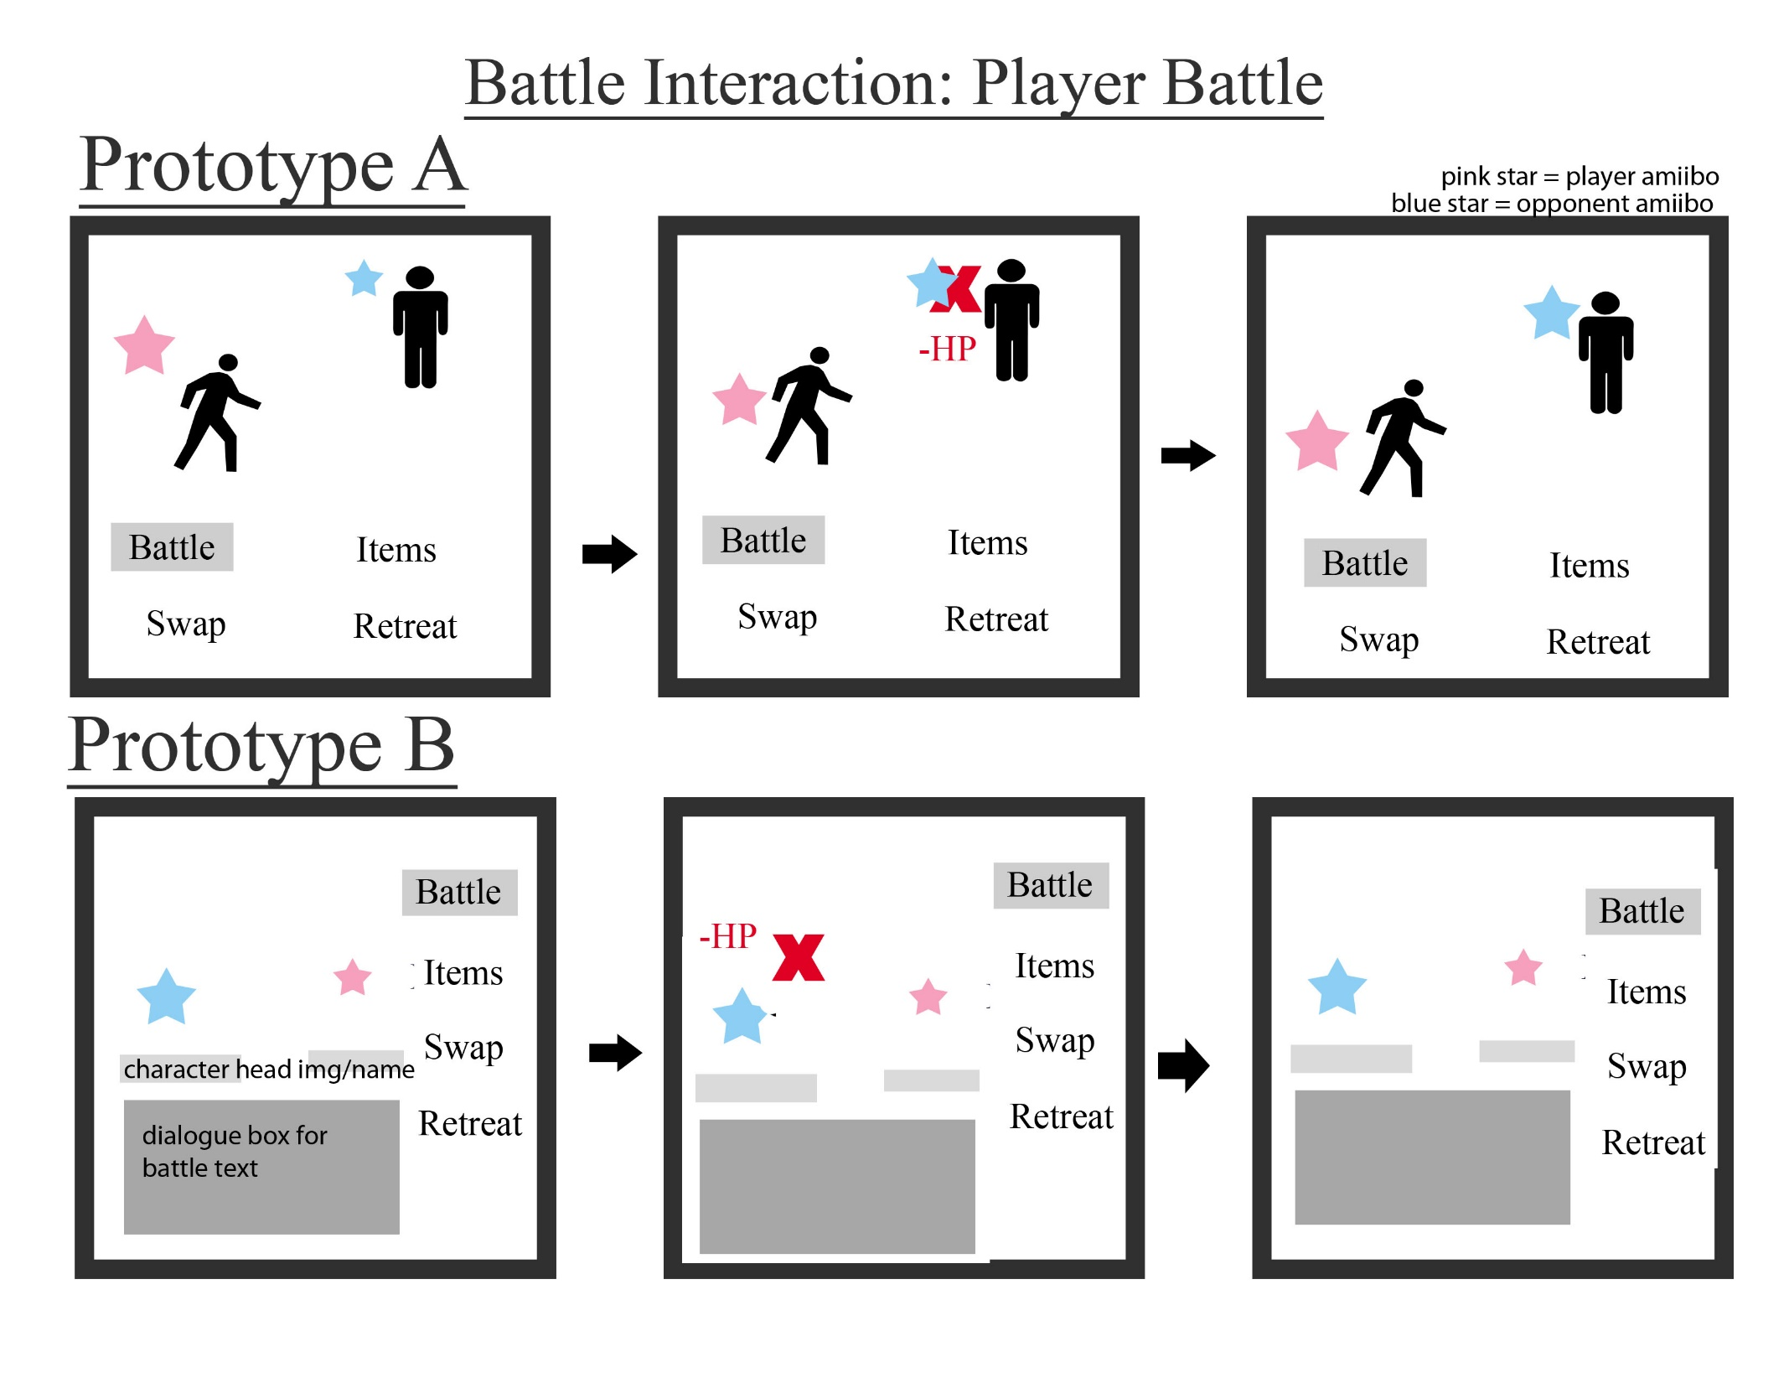
Notes:
This slide shows the player’s attacking turn.
Prototype A
After the player selects Battle like in the left most panel, the screen will display the subtracted hit points to the opponents Amiibo. The battle screen reverts back as the player waits for the opponent’s turn.
Prototype B
Once again, the user selects battle like in the left most panel, the hit points are then subtracted from the opposing Amiibo and the battle screen reverts back as the player waits for the opponent’s turn.
Similarly, we selected to continue using Prototype B’s format. By removing two full body sprites from the screen like in Prototype A, Prototype B allows for much more room on screen to creatively animate Amiibo attacks. The dialogue box on the bottom will be modified to include what kind of attack the Amiibo uses. Multiple attacks can be given to a single Amiibo, varying in range of strength. Therefore, different attack animation can be made to display to the user. This will increase the visual appeal of the battle system and give a more favourable impression of the game to the user. This will also showcase our custom classic graphics. For these reasons, we will continue to improve upon Prototype B.

Slide 11
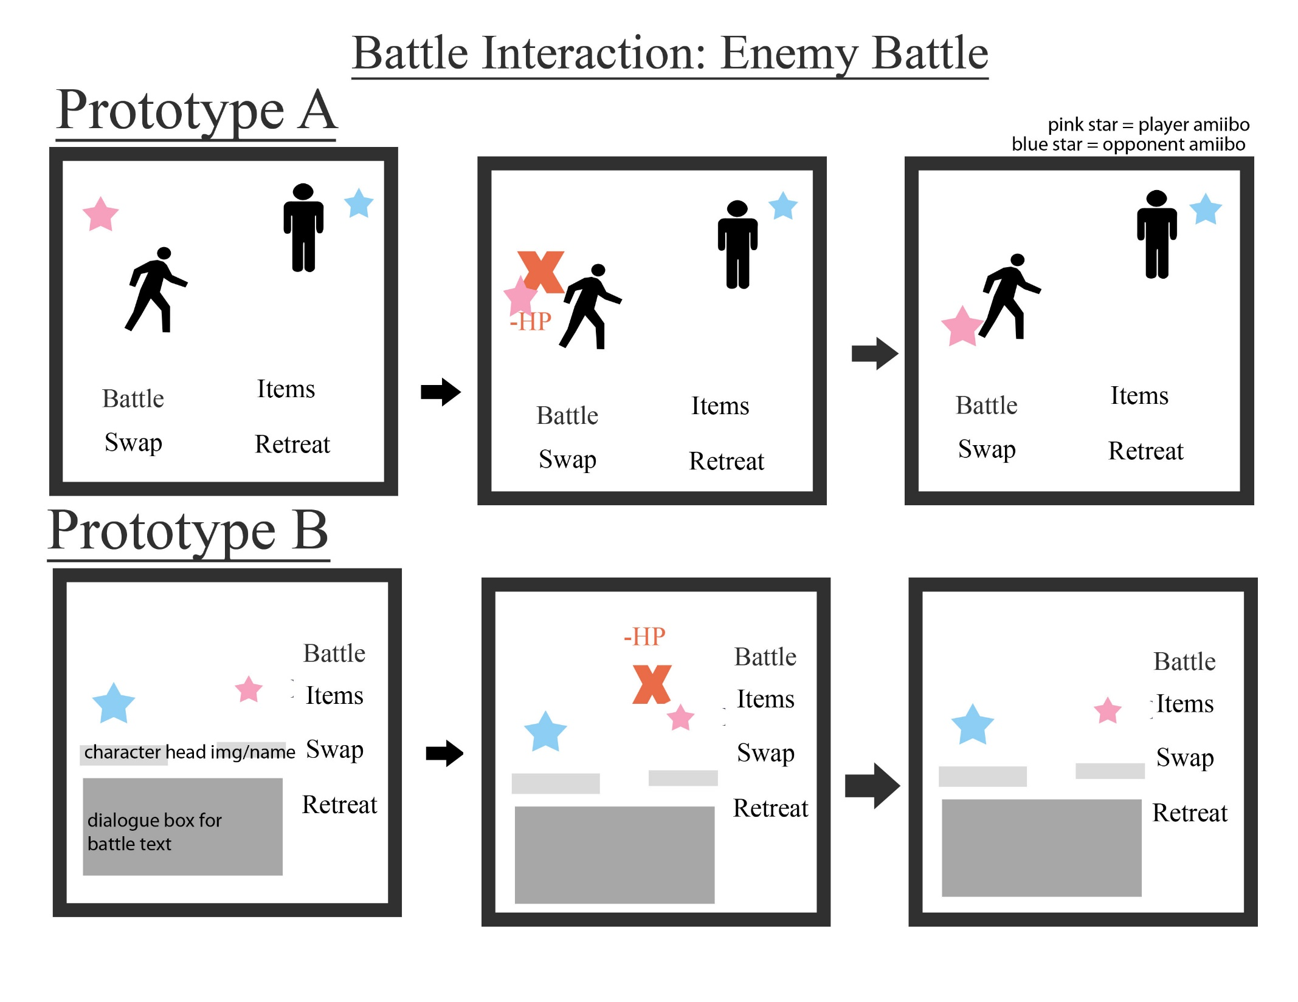
Notes:
This slide demonstrates the Enemy’s battle procedure.
Prototype A
Much like the previous slide, hit points are displayed on screen to the user. This time however, it is the user’s Amiibo that gets hit with damage. The battle will return to the battle screen as the player can begin their turn after the enemy attacks if they haven’t been defeated.
Prototype B
Similarly, the player is unable to attack, use an item, swap, or retreat during the enemy’s turn. The player gets hit with the opponent’s attack and the screen will return to allowing the functions of battle, swap, item, and retreat (if not in a boss battle).
Prototype B will continued to be in use for when the enemy battles the player. This keeps with the continuity of the game and allows the user to see the animation and attacks of amiibos that they perhaps have not collected into their own collection and/or party. The dialogue box will display the actions of the enemy and indicate to the user when they are able to begin their turn.

Slide 12
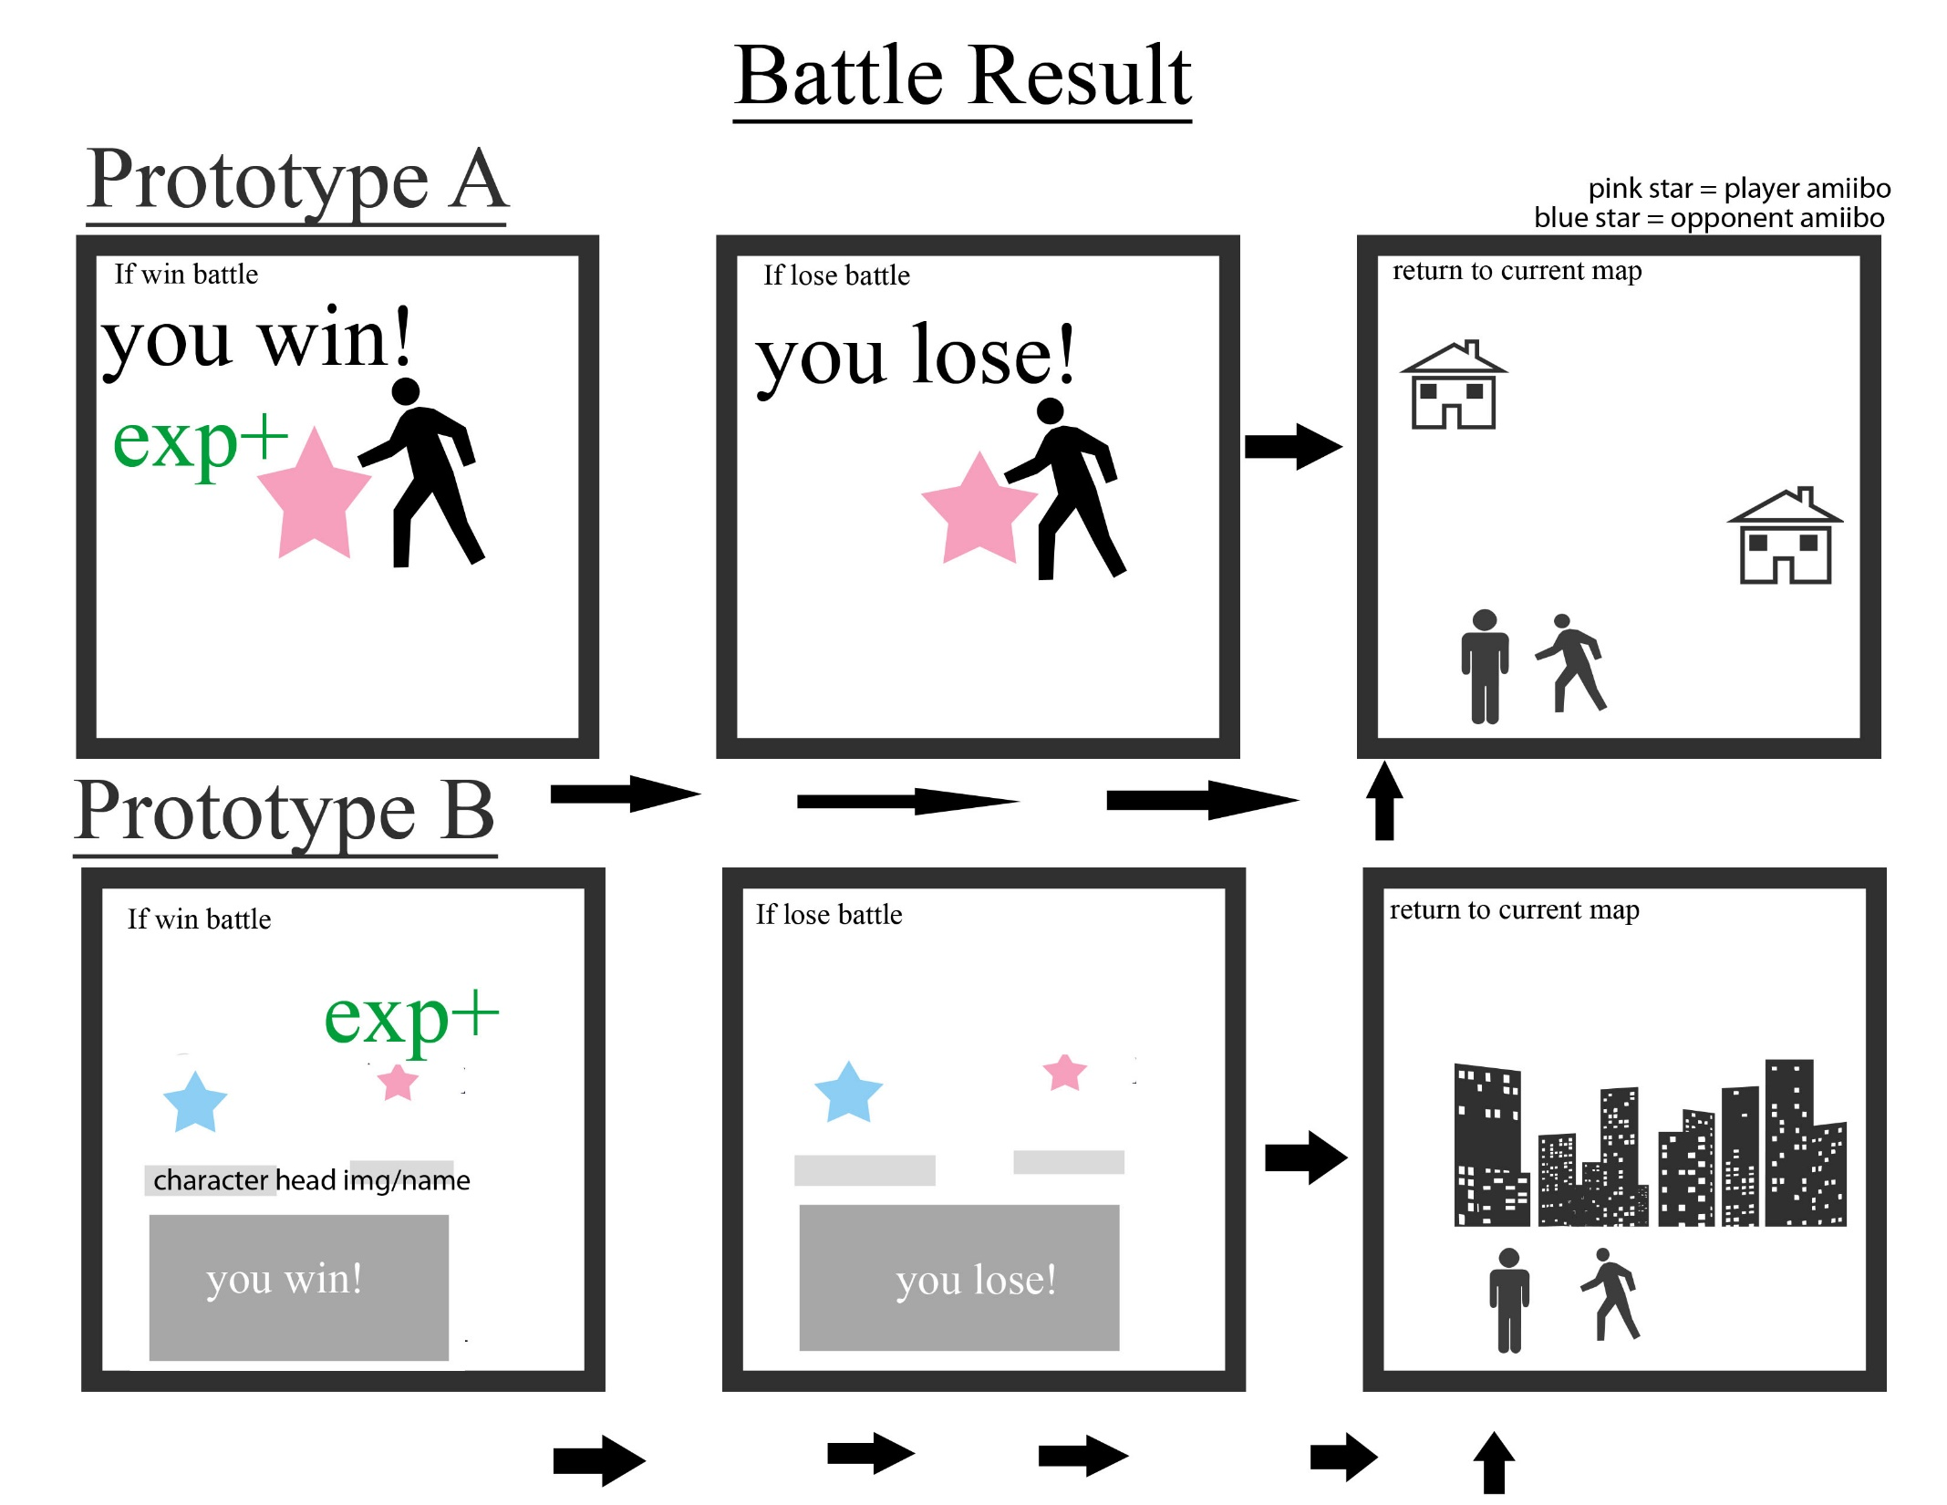
Notes:
This slide shows what happens when the battle has been completed.
Prototype A
After winning the battle, the player and the battling Amiibo(s) appear on a congratulatory screen like in the left most panel. The experience gained is displayed to the user. If an Amiibo has enough experience to level up, that Amiibo will level up during that time as well. This is described as in our features. If the player loses the battle, the center panel will be displayed telling the user that they have lost the battle. No experience points will be gained from this battle. In either case, the player will return to the map there were on before the battle started like in the right most panel.
Prototype B
The left most panel shows the player winning the battle. There is no new screen in this prototype and the result of the battle is displayed in the dialogue box. The experience gained is applied to the Amiibo as well. If the player loses the battle, the result is displayed to the user in the dialogue box and no experience is added to the Amiibo. In both cases, the player returns to the map they were on right before the started the battle.
The battle result prototype we decided to use was prototype A. This was to make a clear indication of the result of the battle. Because gaining experience and levelling up Amiibos is one of our main features, we wanted to come up with a special screen for when it happens so the user knows that this is an important part of the game and story. We feel like prototype A best depicts this feature in our game and we will continue to improve upon this prototype.

Slide 13
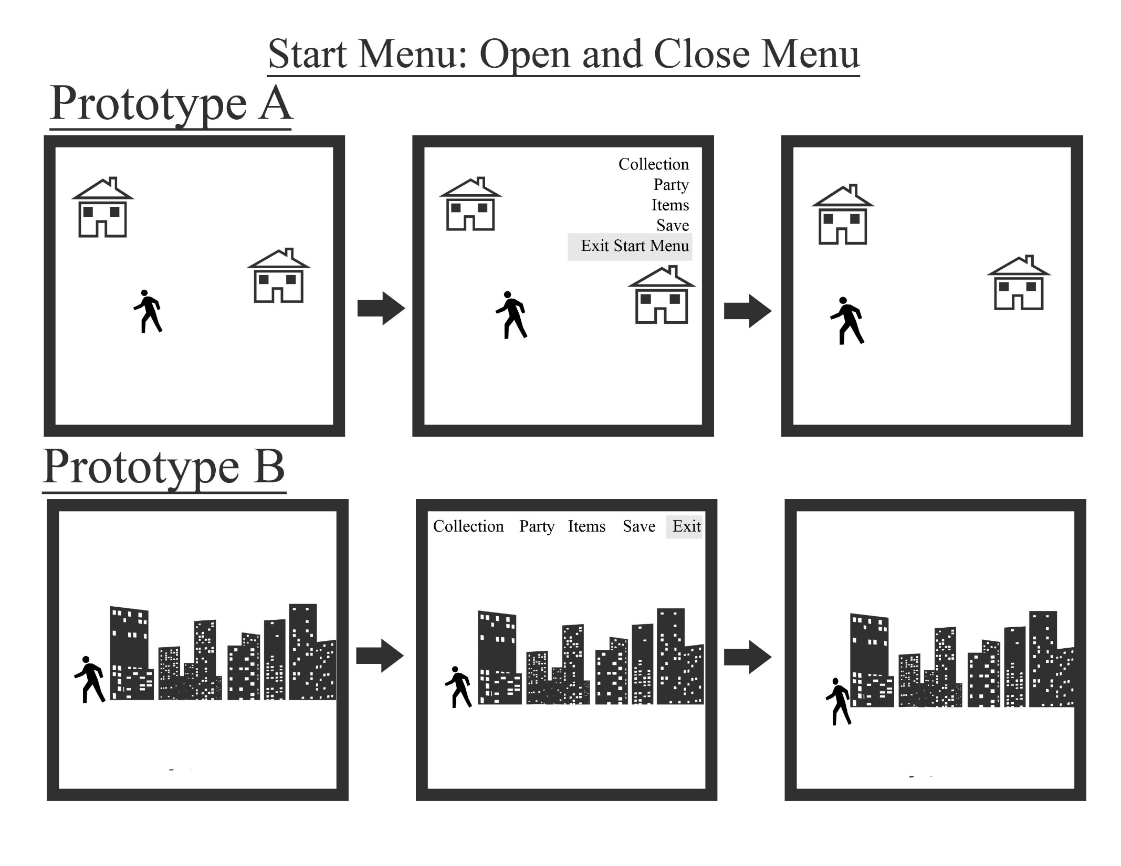
Notes:
This slide shows the availability of the start menu to the user.
Prototype A
Anytime the player is on the map, the player will be able to hit a command and the menu will show up on the screen. This menu will be like the one in the center panel. The options that can be selected by the user are: Collection, Party, Items, Save, and Exit. By choosing to exit the start menu, the menu will disappear like in the right most panel and the user may continue moving on the map.
Prototype B
Similar to Prototype A, wherever the player is on the map, by pressing a command, they will be able to open up a menu that displays the Collection, Party, Items, Save, and an option to exit from the start menu. By hitting the exit option, the player will be able to close the menu and the player can continue moving on the map.
There is not too much to differentiate when it comes to opening a menu in the game. However, in order to continue with the same user interface design, we have decided to use Prototype A. In both cases, when the menu is opened, the player will not be able to move on the map.

Slide 14
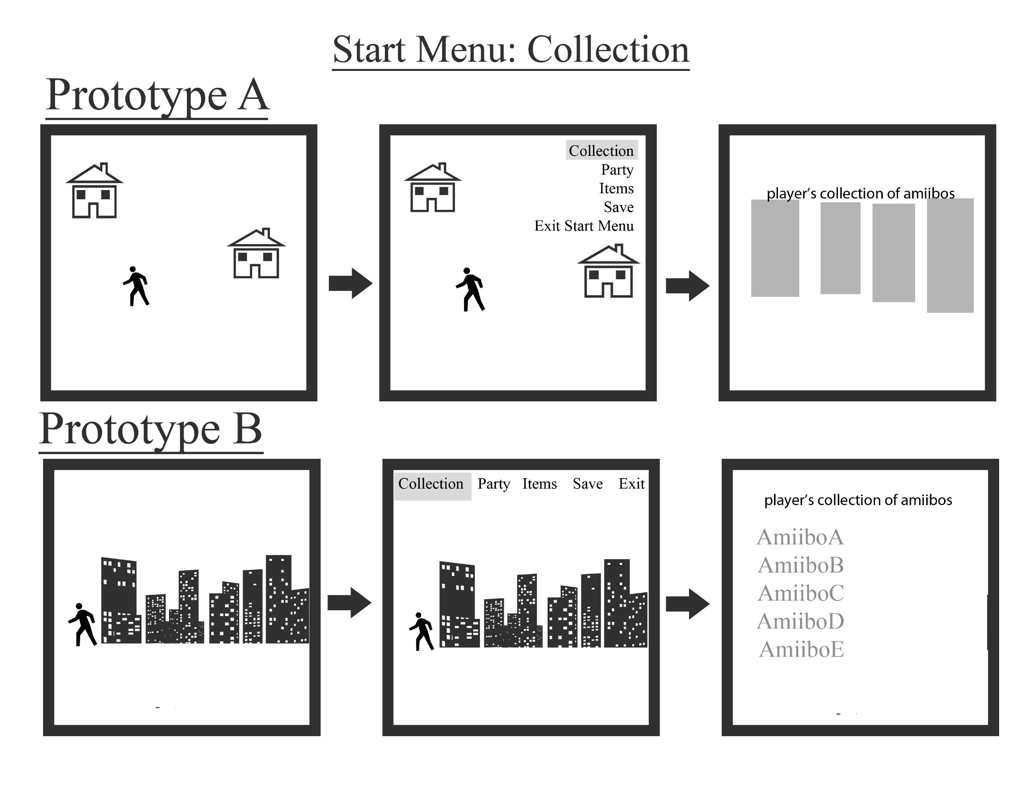
Notes:
This slide will explain the collection menu.
Prototype A
After opening the start menu, the user can select Collection from the menu like in the center panel. The screen will then display the player’s collection of amiibos like in the right most panel.
Prototype B
Again, the collection is opened after opening the menu and selecting Collection. This time, the player’s collection of Amiibos is displayed to the user in text only.
The ability for users to connect with amiibos is one of our game’s strongest selling points. We will proceed with Prototype A where an image of the Amiibo will be displayed to the user. This will result in a more visually appealing game. Players will also be able to see all the Amiibos they have collected so far in the game.

Slide 15
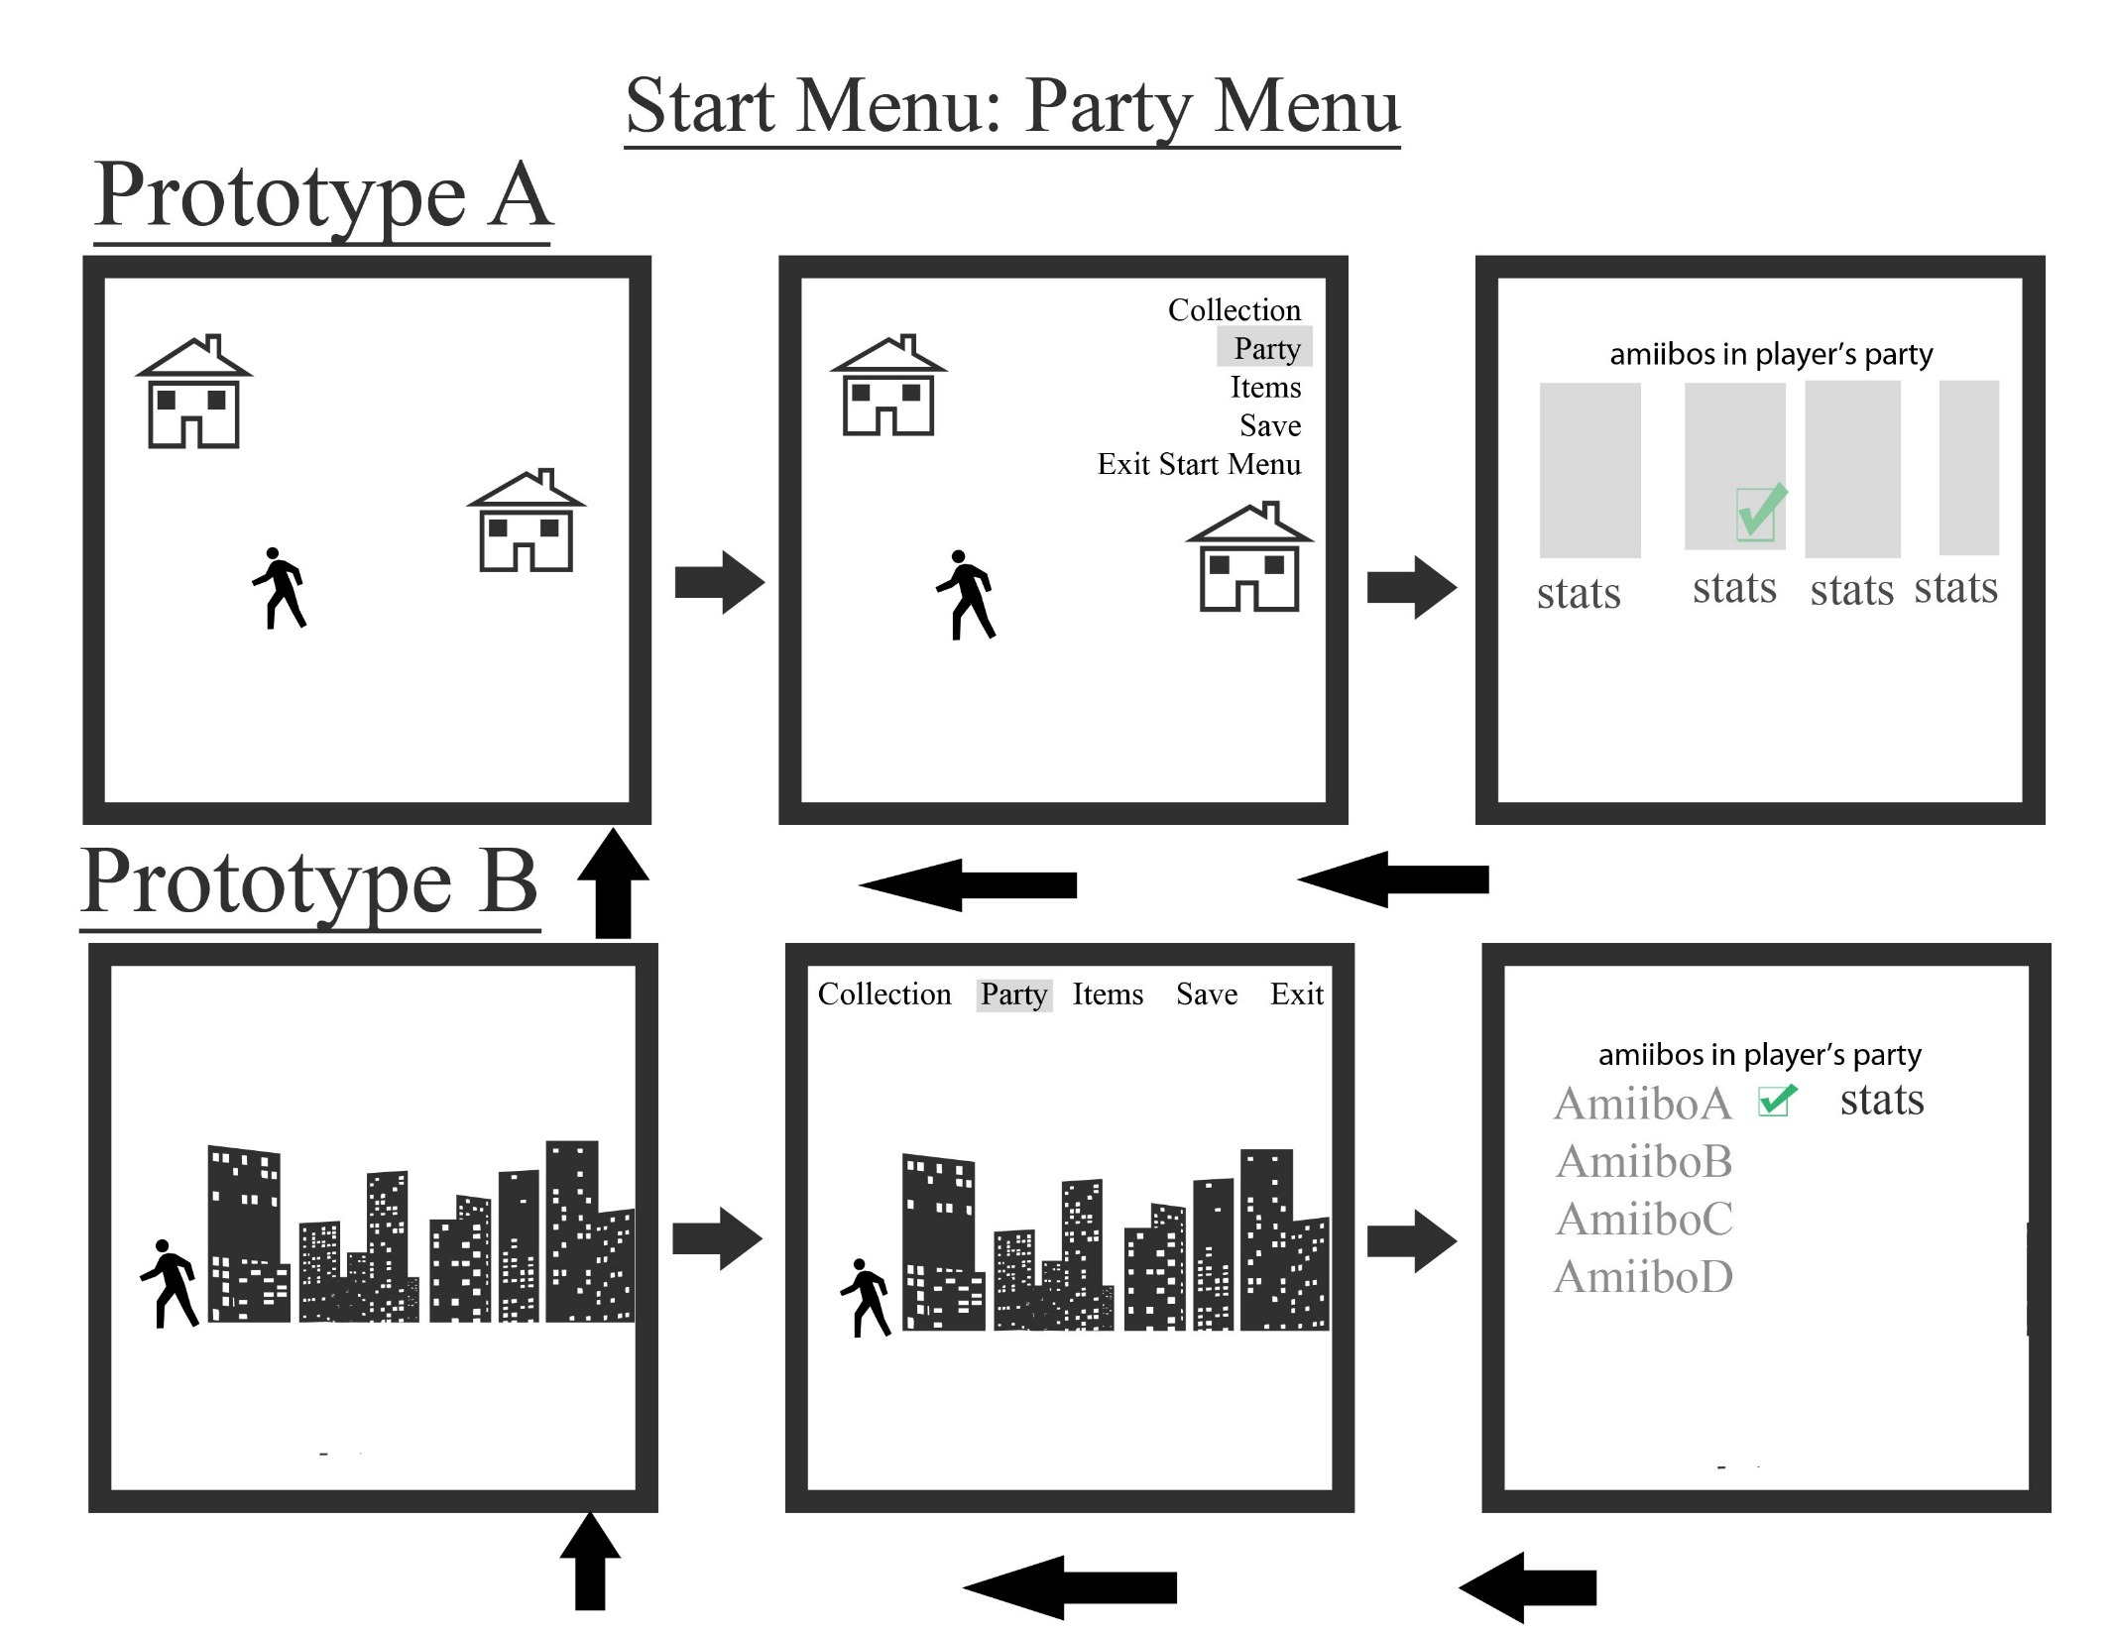
Notes:
This slide explains the party menu
Prototype A
The Party menu is opened from the start menu and selecting party. This can be done when the player is on the map. By opening up the party, the player will be able to view all the Amiibos they currently have available to party with. The first Amiibo sent out to battle is indicated by the check mark in the right most panel. The stats for all the Amiibos in the party are displayed underneath each picture of the Amiibo. Stats will include things like attack points, defense points, hit points, the current level of the Amiibo, and the name of the Amiibo. By exiting from the party menu the player will be brought back to the left most panel where they can continue moving on the map.
Prototype B
The party menu is opened from the start menu on the screen. This prototype shows all of the Amiibos in the party but the user must toggle through the list and select one Amiibo only before being able to view the stats. The same stats will be displayed to the user as Prototype A. Once hitting a command to exit out of the party menu, the start menu will also disappear from the screen and the player will be able to move on the map again.
For the party menu, we have decided to continue with Prototype A. We feel like it would take too many commands for users to have to see the stats of their amiibos in Prototype B. The pictures of the Amiibo will also be displayed to the user. After discussing our game, we would like to make our game as visual as possible. This would be best for the user experience and the promotion of our classic custom graphics. So for those reasons, we will continue with Prototype A.

Slide 16
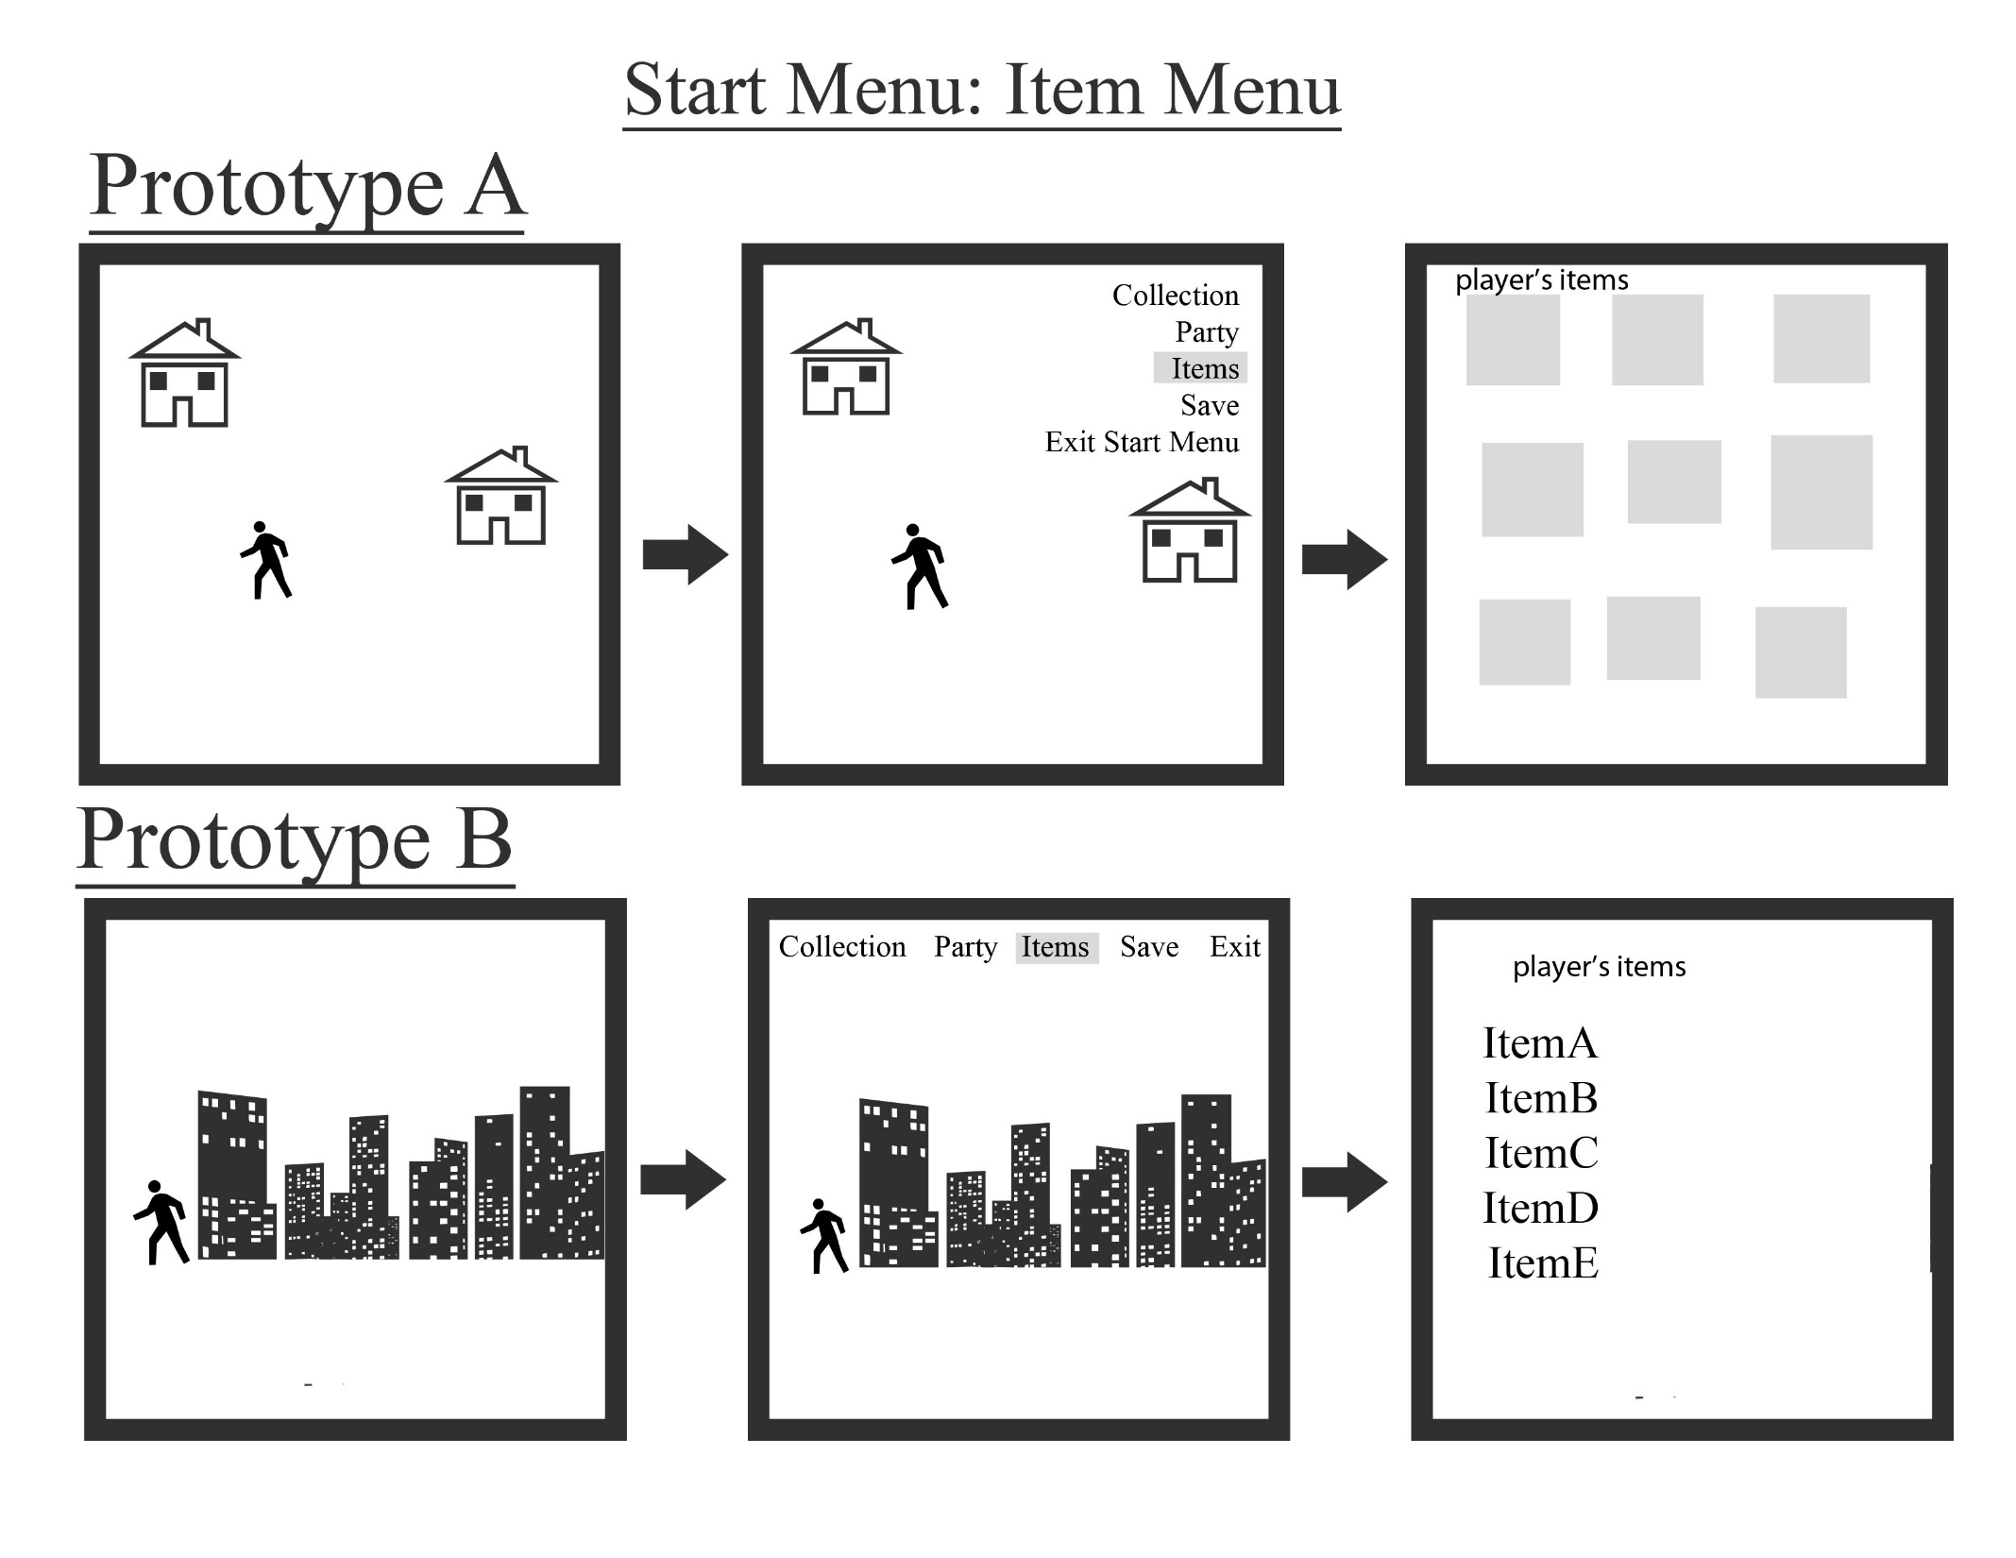
Notes:
This slide shows the Item menu from the start menu
Prototype A
Opening the Item menu of the start menu is the same as Collection and Party. The right most panel shows the boxes which indicate each item the player has as an image and at the corner, the amount the player has of that certain item will be displayed to the player.
Prototype B
The item menu must be selected from the start menu as shown in the center panel. The item’s of the player will be displayed to the user in text. The amount of each item will also be displayed to the user in this time.
The sketches for this prototype continue on the next slide.

Slide 17
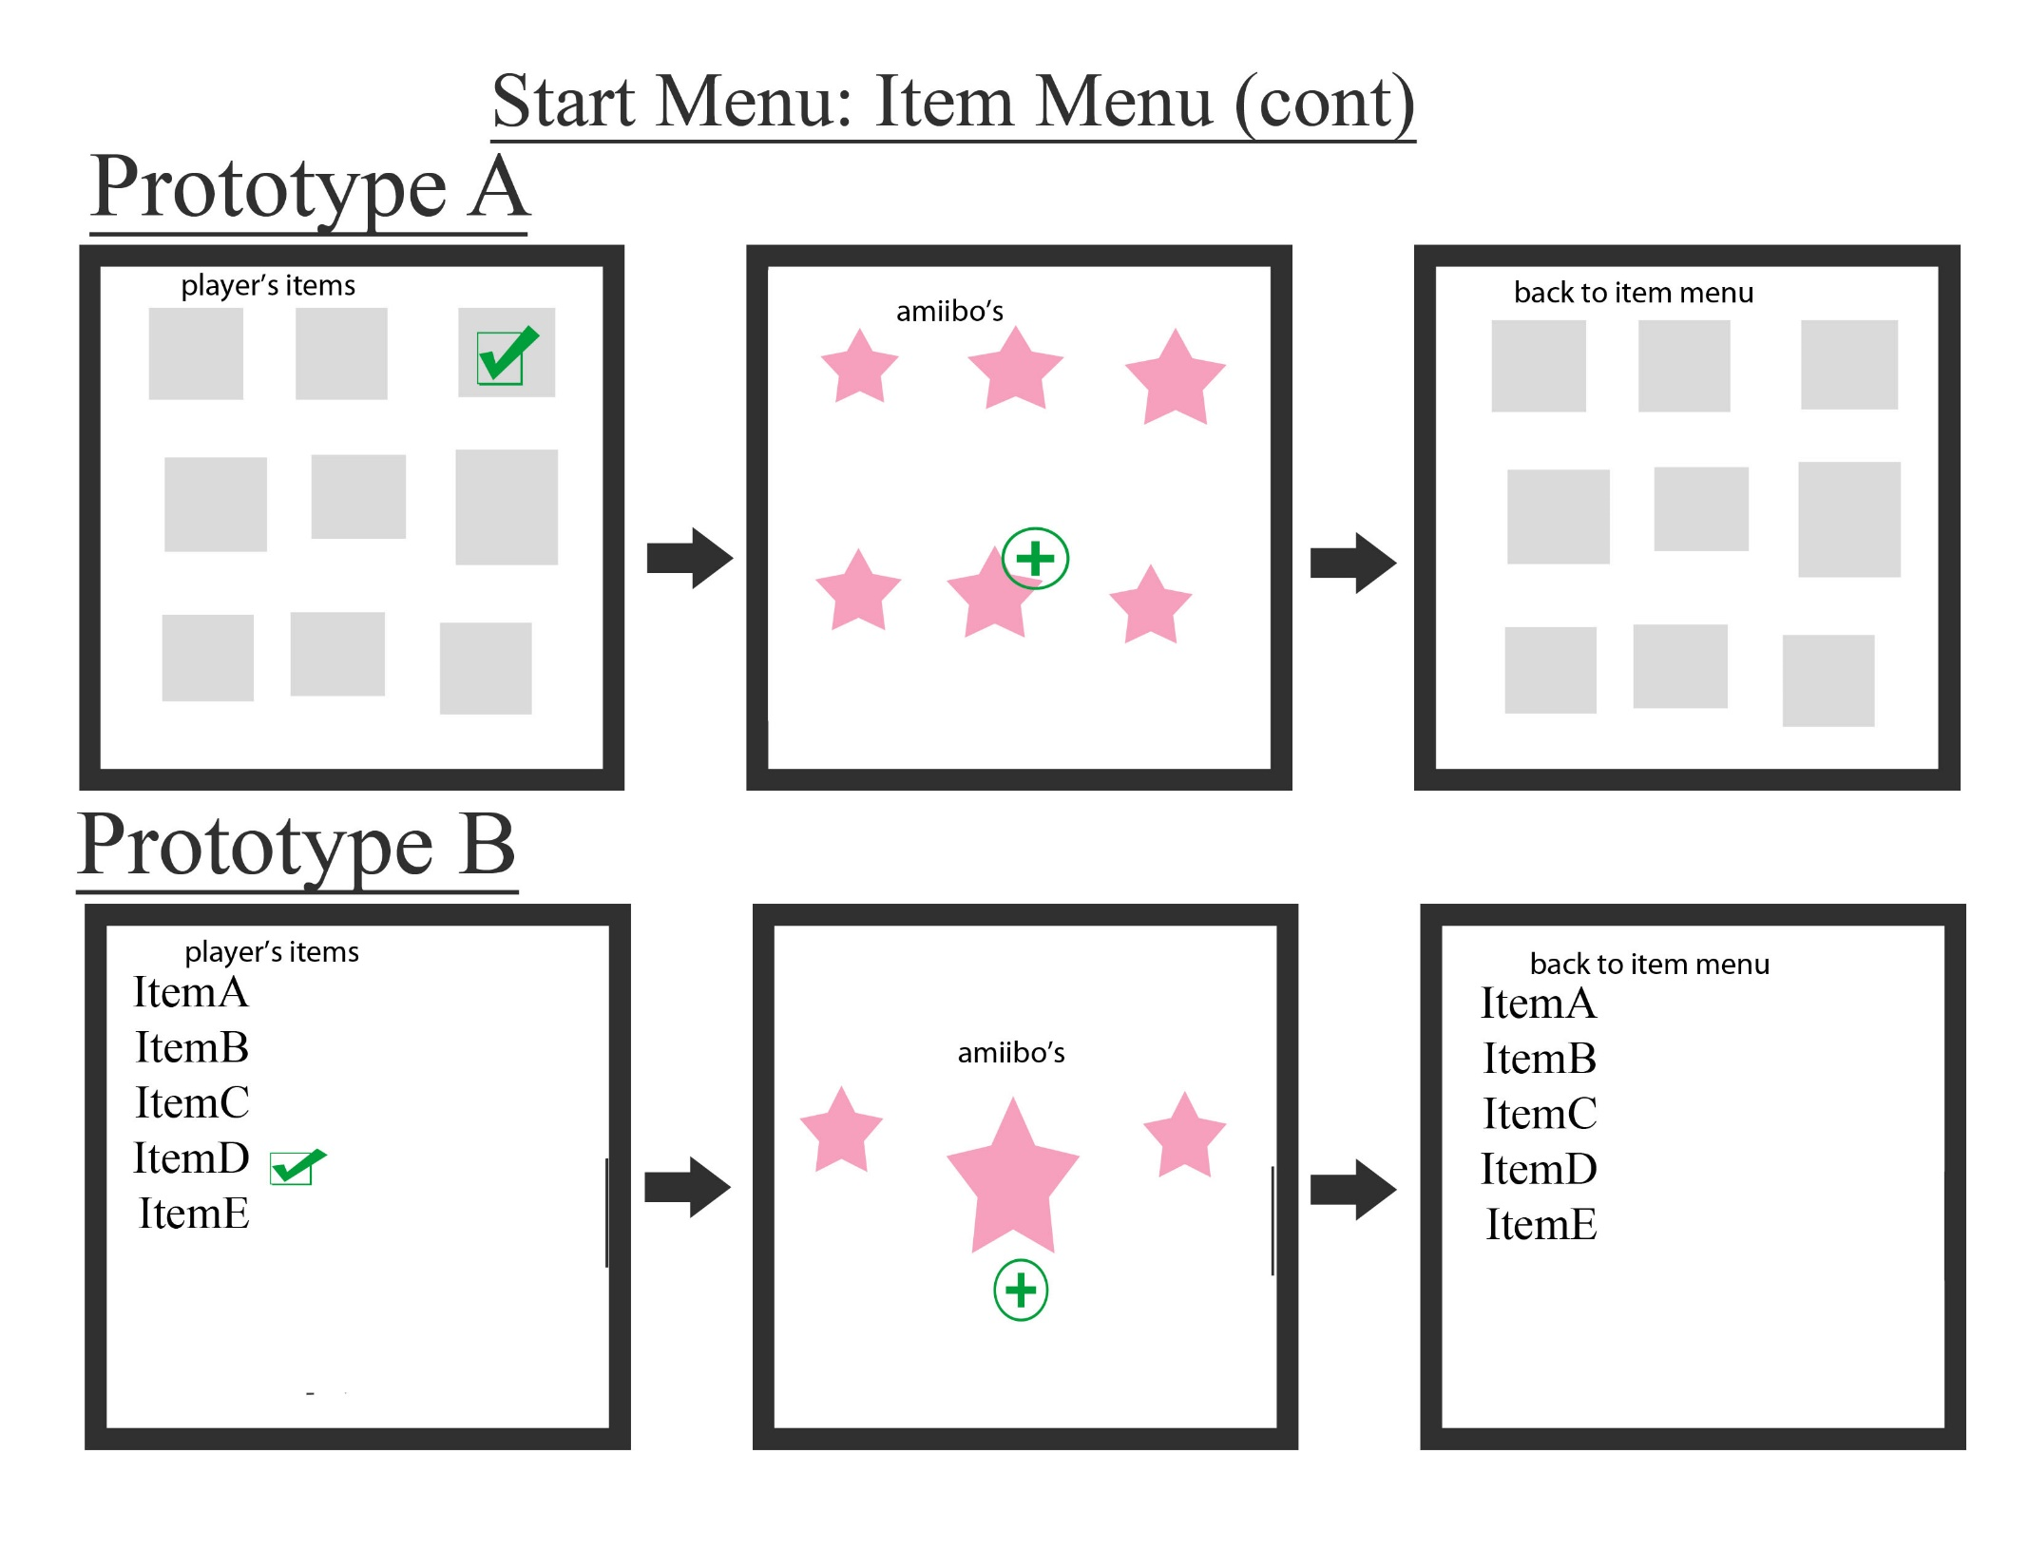
Notes:
This slide is a continuation of the Item menu
Prototype A
Continuing from the previous slide, the user can select an item then the screen moves on to the center panel and the user can choose which Amiibo, as indicated by the pink stars, the item is used on. An indicator will tell the user that the Amiibo has used the item. Underneath the Amiibo, it’s stats will be updated according to whichever item was used. The player will then be able to return to the item menu if they want to use another item. From the items, the player will also be able to move back to the map to continue exploring.
Prototype B
The player will select the item they want to use, in this case, the user has selected ItemD. The Amiibos will be toggled through with the center Amiibo larger than the ones on the side. Three amiibos will be on the screen at any one time. The player can then select the Amiibo that the item will be applied to. An indicator will show which Amiibo has been updated and the player will be taken back to the items menu like in the right most panel. From there, the player has the option to select another item to use or go back to the map and exit the start menu to continue exploring the map.
For the item menu, we had originally planned it so that after using an item, the user is taken automatically back to the map. However, this would be inefficient if the user had wanted to use multiple items. Therefore, we decided to follow the usability guidelines and reduce the amount of interaction the user must do. So now users would go back to the item menu after applying an item to an Amiibo. This would allow the fewest possible commands from the user to use items on amiibos. Once again, we will be using the prototype using the most images. So we will be using Prototype A.

Slide 18
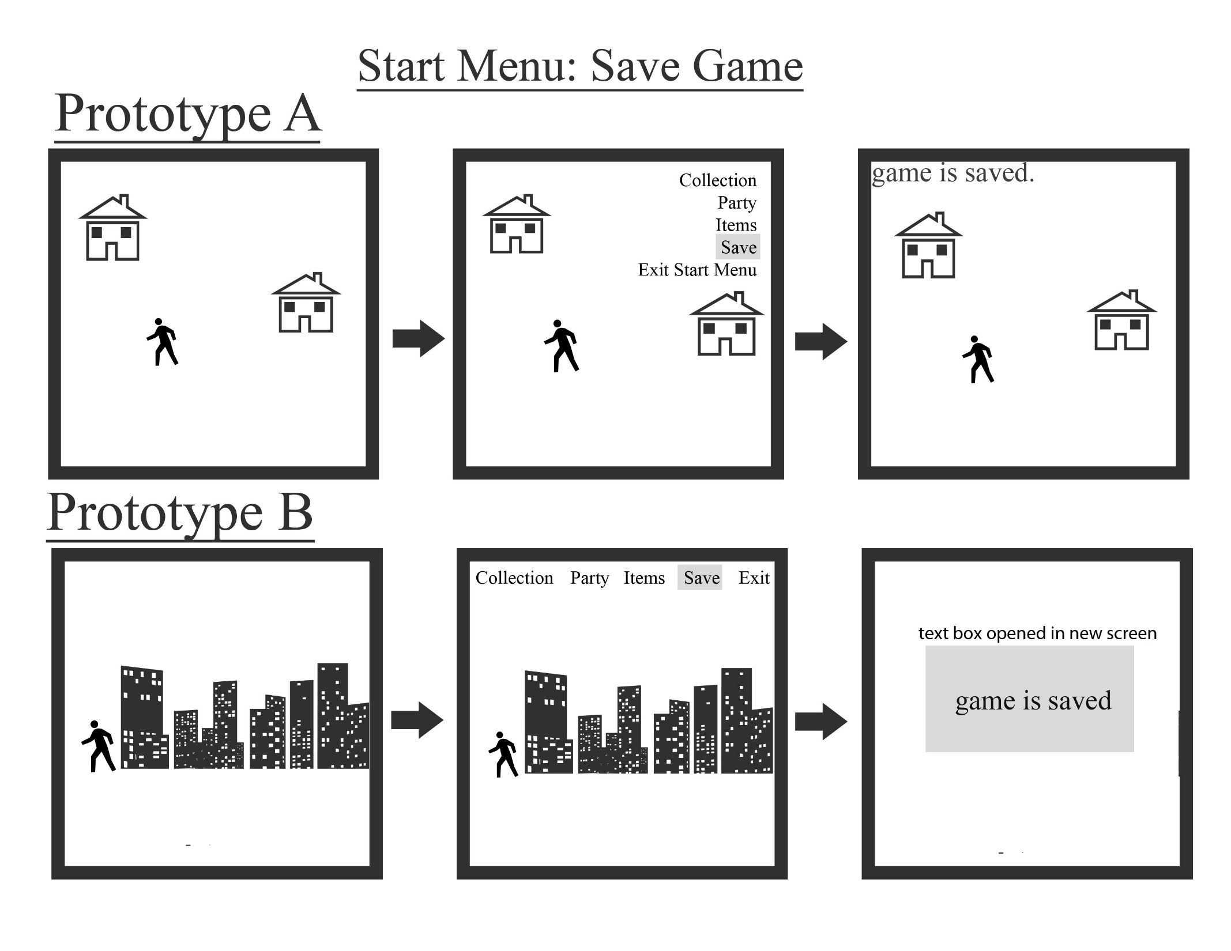
Notes:
This slide goes through saving the game.
Prototype A
The player will be able to save wherever they are on the map. By opening the start menu like in the center panel, the player will be able to select the save option. Then, the start menu will close automatically and text will appear on the screen, like in the right most panel that tells the user that the game is saved.
Prototype B
The player will be able to open the start menu when they are on the map. After selecting the save option like in the center panel, the game moves to the right most panel and to a screen where a pop up box shows that the user has saved the game.
Though there are not many changes to make in a game when it comes to saving, by creating an entirely new screen like in Prototype B, the game takes the user away from the map that they are saving on. The user may want to double check whether they are on the right map and the location of their liking when making the save. By only having text appear on the map screen like in Prototype A, the user will be able to see the map and see that the game is saved. Therefore, for saving the game, we have decided to use Prototype A.

Slide 19
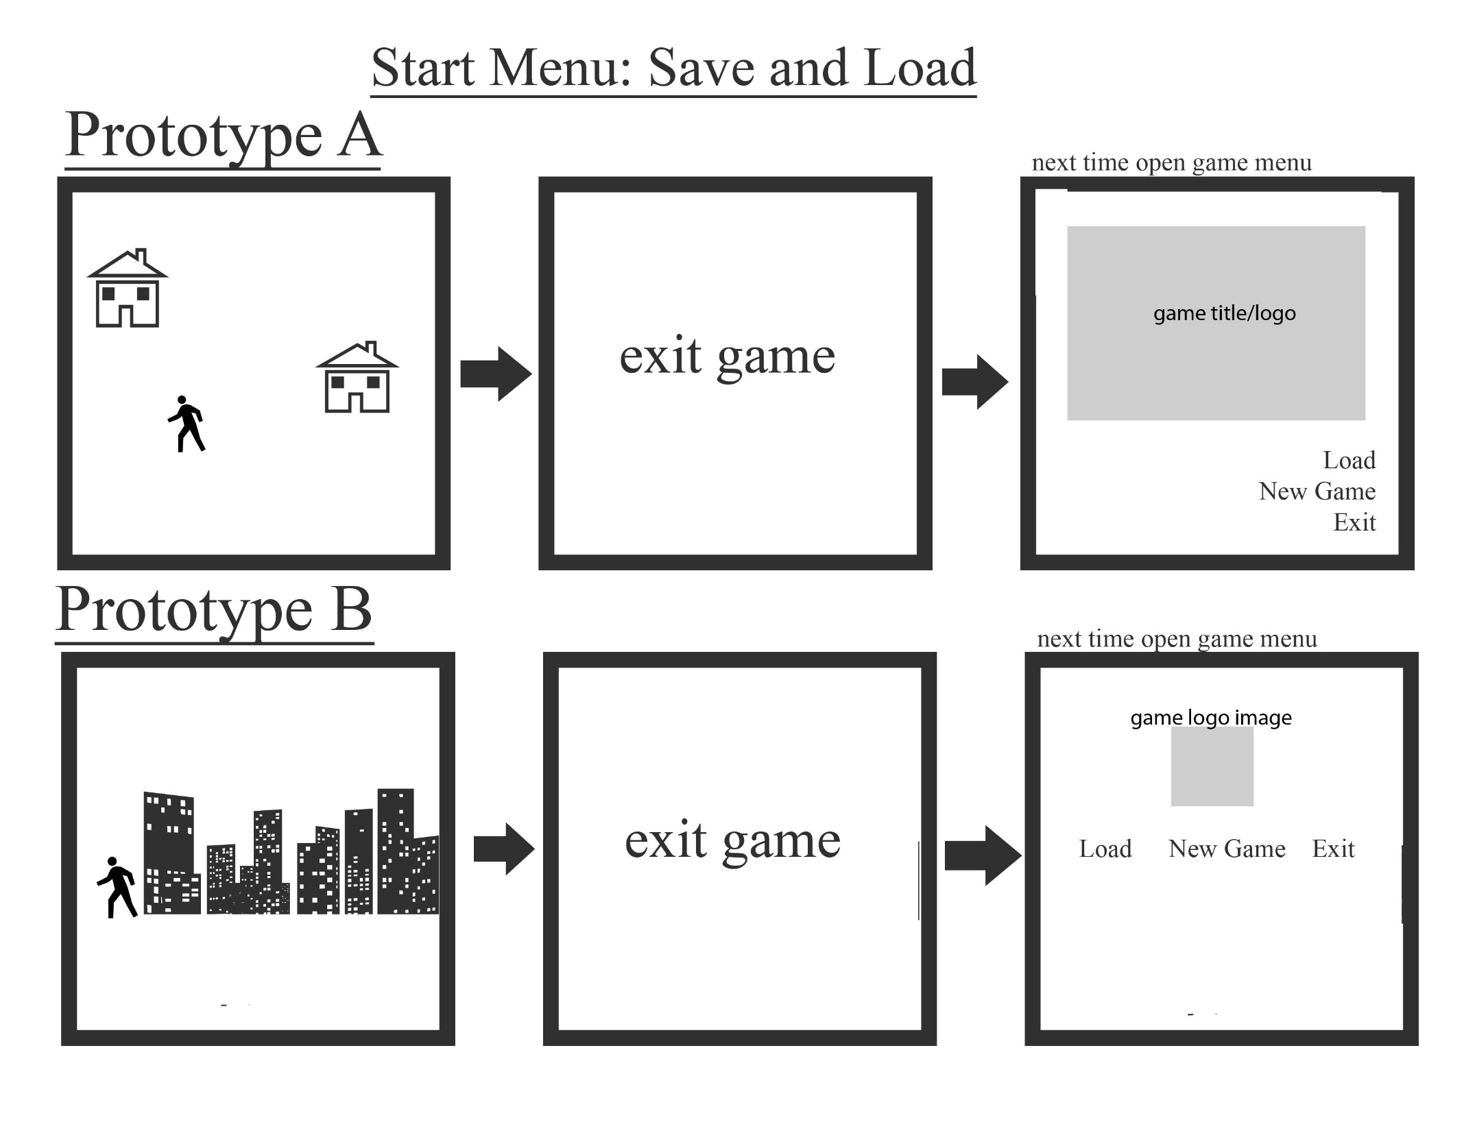
Notes:
This slide will show how the user saves and loads the game
Prototype A
This page follows the previous slide, when the player has successfully saved the game. The player can exit out of the game completely as indicated in the center panel. The next time the player opens the game, like in the right most panel, the start screen will remain the same. However, a new option to Load will be included in the menu. If selected, the user will be able to load their latest previously saved game and continue the game from which map they were on last and on the tile they were last on too.
Prototype B
Prototype B completes the same function, therefore the steps are very similar. The main difference is the layout of the start screen between the two prototypes.
We will be continuing with Prototype A because we don’t want the start screen to be different for the user when they return to the game.

Slide 20
Conclusion
The results gathered from our discussion conclude that:
Users should have a return/back function displayed so they can cancel out of an operation
Better use of encoding techniques to highlight main features of story like the original story, custom graphics, and amiibos
Example, instruction text, graphics, aesthetically appealing colour palettes, group text in dialogue boxes so users can expect information there, background music changes depending on the map and event, animation to highlight the different Amiibo attacks, etc.
Notes:
Continued on the next slide.

Slide 21
Conclusion (cont.)
The game should satisfy RPG enthusiasts and Nintendo fans
The game should also be learnable and memorable to new users
Information should be provided to the user as needed but it should be limited as to not over-crowd the screen.
Instructions should seem familiar to users familiar with RPGs to increase efficiency. Users should be able to learn the UI quickly to perform tasks
Dialogue boxes should contain good feedback to users when an error occurs
- example, if a user tries to use an item they do not have or if they try to interact with something they cannot
Notes:
The discussion was useful in seeing what would appeal to customers.
By following the advice and feedback given after our discussion, we were able to see how many UI changes to our game could help users enjoy our game further.
With the conclusions gathered from the discussion, we will continue to improve on our UI and implementation of the game while keeping our main features and user experience in mind.

